Slide 1
Texas A&M University System Annual Enrollment
Your 2016-2017
A&M Care Benefits At-a-Glance
Notes:
Welcome to the 2016-2017 TAMUS Annual Enrollment Meeting.
Today we will review the changes to the benefits effective 9/1/2016, along with member tools to help you take care better care of yourself.

Slide 2
Plan Overview
What’s New
Beginning 9/1/2016
Benefits (In-Network) | A&M Care (You Pay) | J-Plan (You Pay) | 65+ Plan (You Pay)
Medical Deductible (per plan year) | $400 person $1,200 family | $400 person $1,200 family | $400 person –
Office Visit (per visit) Primary Care Physicians Specialists | $20 copay** $30 copay** | $20 copay** $30 copay** | 20% coinsurance after deductible (no change)
Coinsurance | 20% (no change) | 20% | 20% (no change)
*Out-of-network benefits are also available. When using out-of-network providers, you pay 50 percent after the out-of-network deductible.
**Retirees age 65 and older enrolled in the 65+ Plan are not eligible for copays. Your 65+ Plan benefits are secondary to Medicare.
Please refer to your Benefits Booklet for more detailed information.
Notes:
What’s new?
Beginning 9/1/2016, your PCP / Specialist office visit copays, deductibles and coinsurance will decrease.
A&M Care Plan
Medical deductible will decrease from $700 to $400 per person / $1,200 family
PCP / Specialist office visit copayments will decrease from $30 / $45 to $20 / $30
J - Plan
Medical deductible will decrease from $500 to $400 per person / $1,200 family
PCP / Specialist office visit copayments will decrease from $30 / $45 to $20 / $30
Coinsurance will decrease from 25% to 20%
65 Plus Plan
Medical deductible will decrease from $500 to $400 per person
This chart shows the amount to be paid by the employee or dependent.
The annual deductible is the first amount of money you pay before the health care plan begins to pay. The deductible applies to stress tests, outpatient surgeries, emergency visits and hospitalizations. The deductible applies to each person and has a maximum of 3 per family.
A copay is the amount paid at the time of service for certain medical services. The copay amount depends on whether the doctor is a primary care doctor or a specialist. Primary care doctors are family practitioners, internists, OB/GYNs, and pediatricians –and in this case, also Mental Health Providers --the $20 copay applies. All other physicians are considered specialists. The copay for a specialist is $30.
Coinsurance is the member’s share amount once the deductible has been met. The A&M Care plan pays at 80 percent and the members share is 20 percent.
This chart illustrates benefits when using in-network providers. Coverage for out-of-network providers is also available. When using out-of-network providers, you pay 50 percent after the out-of-network deductible. The out-of-network deductible is $800 person / $2,400 family; these amounts are twice the network deductible.
Note: Retirees age 65 and older enrolled in the 65 Plus Plan are not eligible for copays. Your benefits are secondary to Medicare.
For more detailed information please refer to the online benefits booklet.

Slide 3


SilverSneakers ®
What’s New
Beginning September 1, 2016
  Retirees and their spouses age 65 and enrolled in the A&M Care or 65+ Plan will be automatically enrolled in the Silver Sneakers Program
  No cost to the retiree
    Silver Sneakers
      a comprehensive program designed exclusively for older adults that improves overall well-being, strength and social aspects.
      Retirees will receive information in the mail directly from SilverSneakers® about how the program works, participating locations, an ID card, and a phone number and website available for questions.
Notes:
Beginning September 1, 2016, retirees and their spouses age 65 and older covered under the A&M Care Plan and the 65 Plus Plan will be automatically enrolled in the Silver Sneakers Program –at no cost.
SilverSneakers is a comprehensive program designed exclusively for older adults that improves overall well-being, strength and social aspects
Retirees will receive information in the mail directly from Silver Sneakers about
How the program works
Participating locations
An ID card
Phone number to Silver Sneakers customer service
Web site information that includes member tools.

Slide 4
SilverSneakers ®
What’s New
Silver Sneakers designed for all levels and abilities that provides
  Access to fitness equipment
  Specially-designed, signature exercise classes for all fitness levels**
  pools, tennis courts and walking tracks**
  social events in your community
  online resources with nutrition and fitness tips
Silver Sneakers Locations
  13,000+ fitness and community locations nationwide (you can enroll at multiple locations and visit any one of their locations at any time)
  Access to coed and women-only facilities
**Not available at all locations
Notes:
Silver Sneakers is a program designed for all levels and abilities. It provides
Access to fitness equipment
Specially-designed, signature exercise classes for all fitness levels**
pools, tennis courts and walking tracks**
social events in your community
online resources with nutrition and fitness tips
If you are new to exercise, don’t worry, nearly half of our members had never been to a fitness location before joining SilverSneakers!
The Silver Sneakers gym network includes 13,000+ fitness and community locations nationwide (you can enroll at multiple locations and visit any one of their locations at any time)
To visit a Silver Sneakers gym, you will need your sneakers ID card, proper attire and comfortable shoes!
**Not available in all locations.

Slide 5

SilverSneakers ®
What’s New
Notes:
Some familiar gyms that participate in the Silver Sneakers program
LA Fitness
Anytime Fitness
YMCA
Curves
SNAP
Planet Fitness24hrFitness

Slide 6
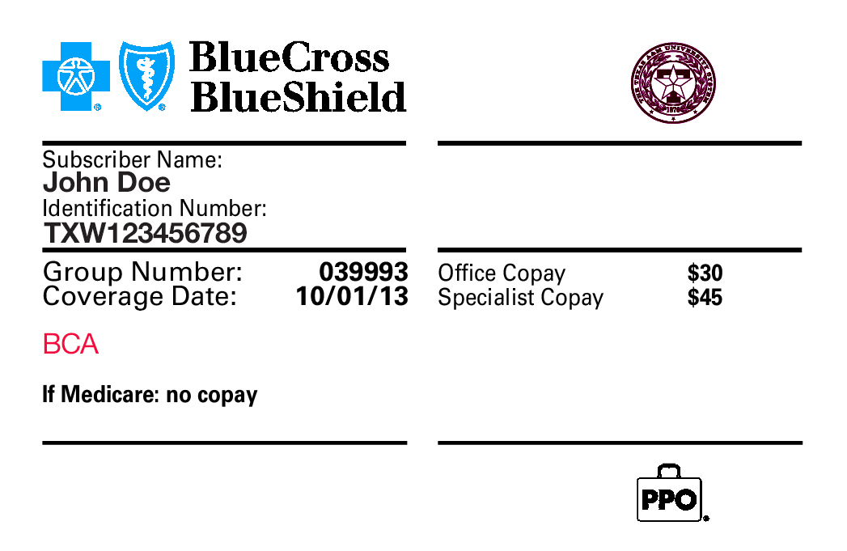
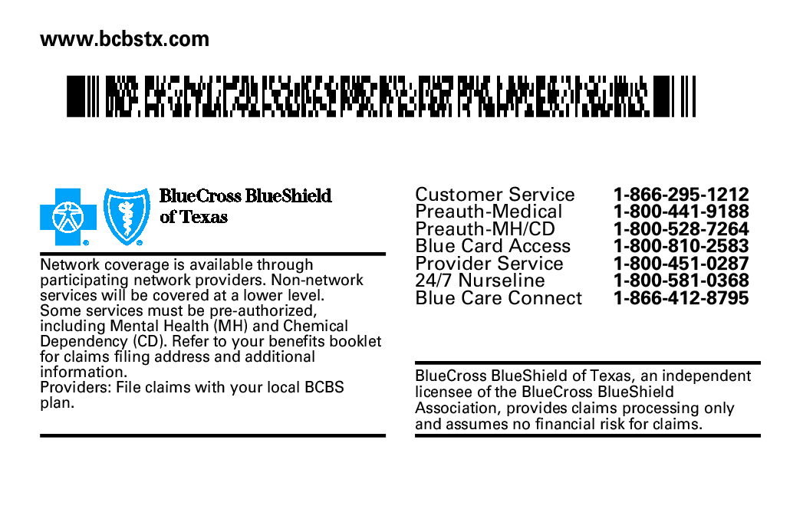

ID Cards Will Be Reissued for 9/1/16
What’s New
Retiree Group Prefix: ZGP
Active Employee Group Prefix: TXW
Need Assistance?
See the back of your ID card for important phone numbers
Website Address
Notes:
6
With the changes for the 2016-2017 benefit year, ID cards will be reissued.
Shown above is a sample ID card for the A&M Care plan and the J-Plan. It lists the effective date this card is in effect, the new copays and the web site has been added to the back of the card.
As a reminder, anytime you need assistance? Your BCBSTX ID card contains phone numbers that you can call for help.

Slide 7
Retiree Information
Retirees under age 65
Are considered Network and can use the Network providers for a copay
Retirees age 65 and older
Choose from:
A&M Care Plan
65 Plus – you must be:
    Age 65 and enrolled in Medicare Parts A&B
    or disabled under 65 and enrolled in Medicare Parts A&B
    Working for the A&M System, if at all, less than 50% time or for less than 4.5 months
    during the plan year
    If covering dependents, dependents must be age 65 or older (or disabled) and enrolled in Medicare Parts A&B
Remember:
Enroll in BOTH Medicare parts A & B.
When you receive your Medicare Card, notify BCBSTX and your Human Resource Office of your Medicare number which includes an alpha character.
If you use a Provider that accepts Medicare or is a BCBSTX provider, you cannot be balance billed.
Notes:
If you are a retiree under age 65, you will receive the same benefit as when you were working. You will want to continue using the Blue Choice network providers to receive the highest paid benefits.
Retirees age 65 and older may choose from two plans – the A&M Care Plan, and the 65 Plus Plan.
However the benefits are exactly the same for the 65 Plus and the A&M Care plans except for a lower out of pocket maximum in the 65 Plus Plan. It is to your advantage to choose the 65 Plus Plan if eligible because of the lower out of pocket maximum and the lower premiums.
In order to enroll into 65 Plus Plan you must be:
Age 65 and enrolled in Medicare Parts A&B, or disabled under age 65 and enrolled in Medicare Parts A&B
Working for the A&M System, if at all, less than 50% of time or for less than 4.5 months during the plan year
If covering dependents, all dependents must be age 65 or older (or disabled) and enrolled in Medicare Parts A&B
A few points to remember:
When you become eligible for Medicare at age 65 (or earlier if due to a disability), always enroll into both Medicare Parts A&B. Part A of Medicare is usually available at no charge and Part B of Medicare does have a premium attached to it.
If you elect to enroll in Medicare, please inform Blue Cross and Blue Shield of Texas and your Human Resource Office of your Medicare information as quickly as possible. We will need your Medicare Part A&B effective dates and your Medicare ID number.
If you elect not to enroll in Part B, the A&M Care Plan and 65 Plus Plan will process claims as if Medicare had paid 80 percent, paying only the 20 percent of the billed charge leaving you with a large balance to pay.
If you are working for the A&M System for 50% time or more for 4.5 months or more during the plan year, Blue Cross and Blue Shield of Texas is your primary payer. If you work September through May, your A&M Care plan will remain primary through the summer, even though you are not working.
You may use any provider of your choice. However if the provider accepts Medicare or contracts with Blue Cross and Blue Shield of Texas, you cannot be balance billed.
If you are retired and know for sure that you are working for the A&M System at least 50% time for 9 or 12 months, you do not need to enroll in Part B. If you are not sure you meet the 50% requirement, you should enroll in Part B just in case.

Slide 8

Preventive Coverage
Get an annual physical to be sure you get the lowest premium!
What’s covered?
  Recommended routine gender- and
  age-specific preventive care, such as annual physical, OB/GYN exams, mammograms and other cancer screenings, well-child care and immunizations – both facility and professional services
  Preventive coverage provided in-network at 100% with no copay, no deductible
Inform your doctor’s office that you are scheduling your “annual wellness checkup”
Remember: Lab tests related to an illness or condition are not considered preventive and may be reimbursed differently
Notes:
Texas A&M University System encourages preventive care and good health. They recommend members get their routine preventive care services such as physicals and ob-gyn exams, mammograms and other cancer screenings, well-child care and immunizations.
Preventive care is covered at 100 percent without an office visit copay when using a network provider. When using a non-network physician for preventive care, there is no coverage and the plan will not pay the claim.
Remember: When you get an annual physical, you will be eligible for the lower wellness premium for the upcoming benefit plan year, September 1 under the Wellness Exam Incentive.
Wellness Exam Incentive Highlights include:
Have a wellness exam between September 1 and June 30
This incentive applies to employees AND covered spouses enrolled in the A&M Care Plan.
A premium differential of $30 per month will be added to the premium for each individual (you and your covered spouse) who does not complete the wellness exam incentive by the June 30 deadline.
Retirees automatically receive the lower premium.
Blue Cross Blue Shield of Texas will record the incentive completion through the claims payment process.
You can verify your completion status for the wellness exam incentive by logging into your MyEvive account.

Slide 9
Preventive Care Immunizations —
Covered at 100%
If you are an active employee and you want to get a shingles vaccine:
Option 1: Go To Personal Physician | Option 2: Go to Walgreens or HEB
Present your ID card | Present your BCBSTX ID card (Pharmacy files claim under BCBSTX Medical Provider Number)
If you are 65 or older, or Medicare-eligible and you want to get a shingles vaccine:
Option 1: Go To Personal Physician | Option 2: Go to Walgreens or HEB
Present your ID card | Pay the full cost File the claim with Medicare File claim along with the Medicare explanation of benefits with BCBSTX
Notes:
Immunizations, including the shingles vaccine, are covered at 100%.
Simply present your ID card to your personal physician to receive the vaccine at no charge.
If you are an active employee,
you can also go to Walgreens or HEB for your vaccine and simply present your ID card. The pharmacy will file a claim for you, using the BCBSTX medical provider number.
If you are Medicare-primary and get your vaccine at a pharmacy, there is a multi-step process to receive 100% coverage of your vaccination:
You must pay the full cost of the vaccine out of pocket at a pharmacy. Pharmacy cannot bill “medical” to Part B. Only pharmacy to Part D.
Then, you must submit medical claim with Medicare Part B.
Medicare will deny the claim and send you a denial letter/Explanation of Benefits (EOB).
File the claim with the medicare explanation of benefits with BCBSTX for reimbursement.
BCBSTX reimburses you for the vaccination.

Slide 10


BLUE CARE CONNECTION®
COMPLEX CONDITION
CHRONIC CONDITION
AT-RISK
HEALTHY
An active approach to integrated health management.
866-412-8795
Well onTarget®
Health Assessment
Biometrics
Preventive care
Member Portal and online tools
24/7 Nurseline
Behavioral Health
Lifestyle management
Utilization management
Special Beginnings®’ maternity program
Care Coordination and Early Intervention
Blue Care Advisors nurse coaching
Condition management
Case management - complex and catastrophic
10
Notes:
Under the Blue Care Connection Program, we engage members anywhere on the spectrum --whether they are healthy or have a chronic condition-- we have the tools to help you manage your health.
If you're on the healthy end of the spectrum,
you can utilize the tools shown under the Healthy column, such as a Health Assessment, 24 Nurse Line.
If you have a chronic condition such as such as
asthma, COPD, diabetes, heart disease, low back pain or metabolic syndrome, you can utilize the tools under the chronic condition column and enroll in the condition management program.
If Blue Cross Blue Shield of Texas identifies you with a chronic condition and you’re not enrolled in the condition management program
a Blue Care Advisor will be calling you at home, work or on your cell phone to encourage you to enroll.
A Blue Care Advisor is a clinical advisor
their role is to help you manage your chronic health condition, understand physician's orders, and establish goals and schedule follow-ups if needed.
If you’re not already enrolled in condition management and have a chronic condition,
we encourage you to call the number listed here (866-412-8795). The number for Blue Care Connection is also listed on the back of your ID card.

Slide 11
Member Tools
& Services
Your 2016-2017
A&M Care Benefits At-a-Glance
Notes:
11
Let’s move to other member tools and services available under the A&M Care plan.

Slide 12
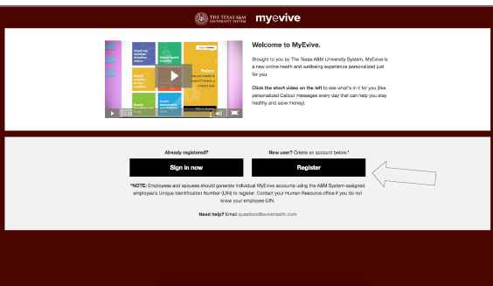
MyEvive
tamus.myevive.com
Notes:
My Evive is your new member portal that allows you to access all things related to your medical benefits.
To log on, simply go to this web site shown above. Please remember to save this link as a favorite for future reference.
If you’ve never logged on, we encourage you to watch the tutorial posted on the login page to familiarize yourself with the portal.
As a reminder, your ID Number is your employee ID number (aka UIN). You’ll need this in order to register and/or login.
This tool is available only for employees and their spouses, not retirees.

Slide 13
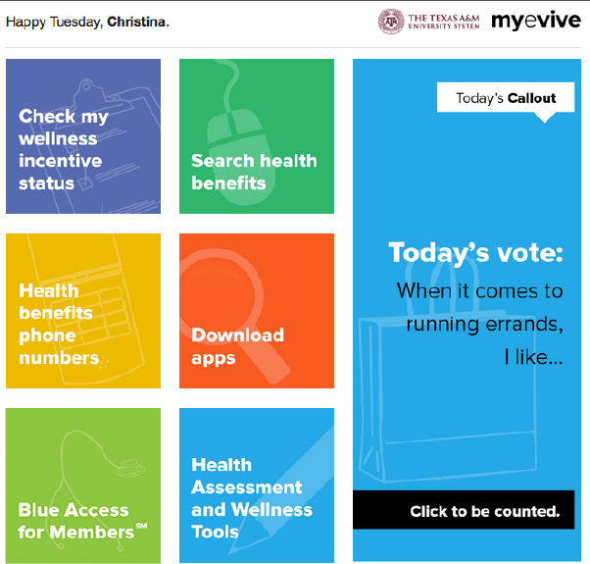
MyEvive
Notes:
Once you’ve logged in, here’s what your home page looks like. Let’s review each tile.

Slide 14
MyEvive
Incentive status for
annual physical
and health assessment
Plan booklets
Notes:
.
Under Check My Wellness Incentive status, you can check the status of your annual physical and your health assessment.
Search health benefits lists your plan benefit booklets which explain the details of the plans.

Slide 15
MyEvive
List of contacts with
click to chat feature
List of Apps
Notes:
Health Benefits Phone Numbers includes a list of carrier contacts, their phone numbers.
Download apps includes a list of apps from medical and pharmacy carriers

Slide 16
MyEvive
Check your claims
Order ID cards
Search for providers
Take Health Assessment
Well on Target: Sync
your fitness device,
access health & wellness
info, self-directed courses
Personalized messaging

Slide 17
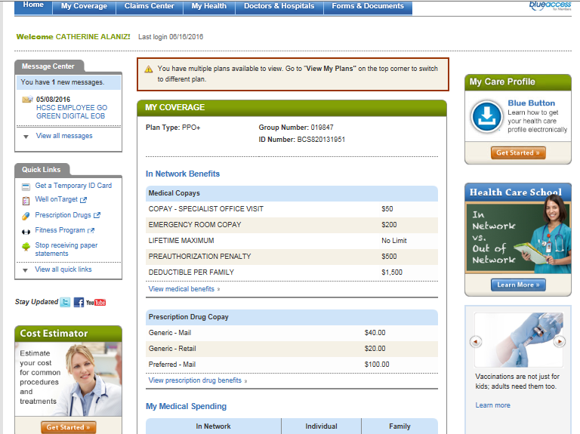



Cost Estimator
Blue Access for Members (MyEvive)
Click on ‘Get Started
Notes:
From your Blue Access for Members Home Page, you can access tools to help you control medical out of pocket expenses.
Here’s how!
Click on the “Get Started” button to access the “Cost Estimator” tool.

Slide 18
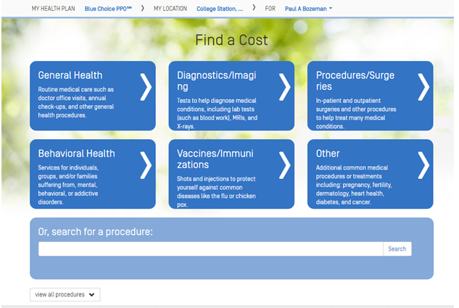
Cost Estimator
Click on tile
or
Search
Notes:
The defaults are defined at the top of this next page
The tool identifies your current location –this can be changed by clicking in the field and typing a different city and state.
There are two ways to search for your procedure
Select the appropriate tile that applies to your search
Type in the name of your procedure
If you select a tile, you will be prompted through a series of similar tiles in order to find your exact procedure.
.

Slide 19
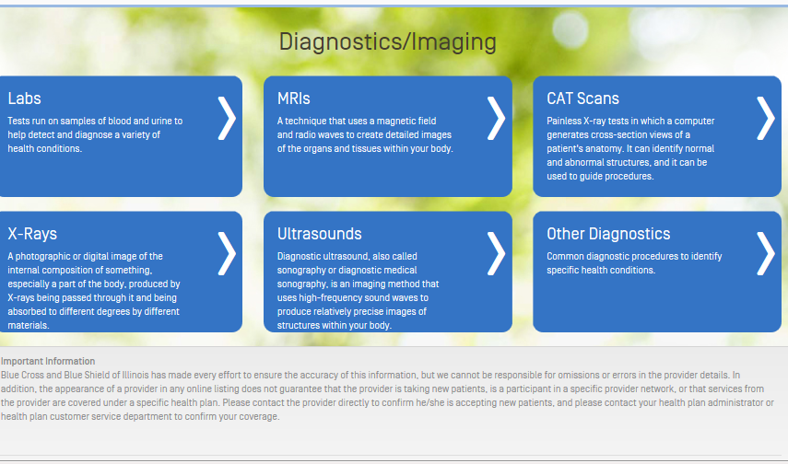
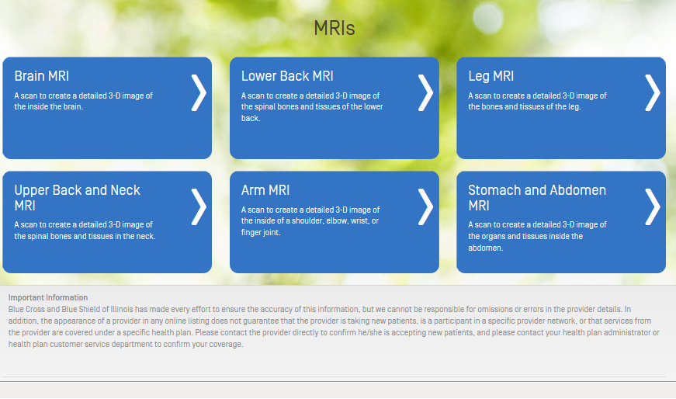

Cost Estimator
Select next option
Notes:
In this example,
I selected Diagnostic/Imaging on the previous page which brought me to the list of diagnostic procedures. As you see here in the upper left hand corner, my options are Labs, MRI, CAT Scans, etc.
I select MRI as my option, and then receive a new set of tile options as you see in the lower right hand corner.
I select the MRI procedure applicable to me. My options are Brain, Lower Back, Leg MRI, etc.
I select Lower Back MRI which begins my search…. (next page)

Slide 20
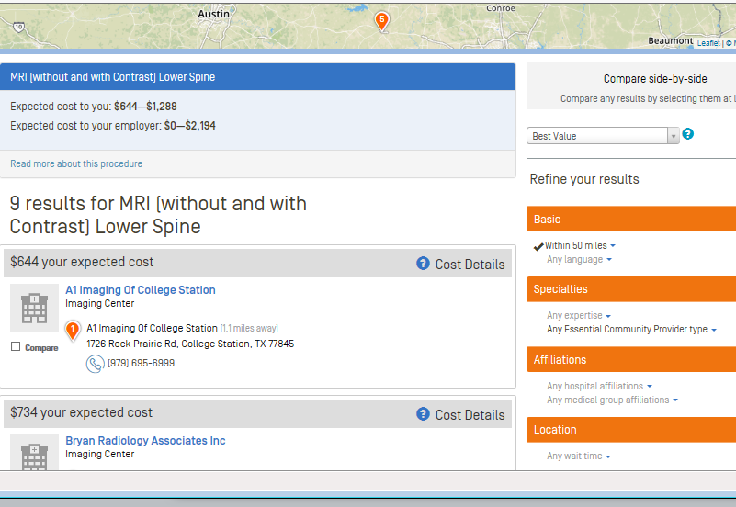

Cost Estimator
GPS Mapping
Expected Costs By You
Search Results
Hover over Cost Details
for pricing
Notes:
Here are the results of my search.
Note the results include GPS mapping at the top of the page.
Expected Costs for my procedure are between $644 and $1,288
The search yielded 9 MRI providers for my specific procedure
And, if I hover over “Cost Details”, I am able to view my patient share if I choose this facility.
The Cost Estimator is an estimation. Other services may factor into an increase in higher out of pocket costs. For example, the anesthesiologist or assistant surgeon may be called in; these are not factored into the estimation.
Whenever possible, please verify all providers associated with your procedure are in the network.

Slide 21

Fitness Device Integration with Well onTarget
SYNC. MOVE. ACHIEVE.
16 Apps/Devices Including Fitbit, Jawbone, Nike Fuel Band, and Garmin
Great Rewards Fitness device activity adds to Life Points.
Well onTarget Member Dashboard
Minutes exercised, steps taken, calories burned, and more
21
Notes:
If you are one of the many that use a fitness device to track your wellness goals, you can now integrate your device with Well onTarget –You can access Well on Target through My Evive under the “Health Assessment & Wellness Tools” tile.
The devices we support are:
Fitbit, Jawbone, Nike Fuel Band, Garmin, Misfit Shine, Sync Series, Body Media, iHealth wireless activity and sleep tracker, Withings pulse activity tracker, Omron and Fitbug
If you are using an APP to track your well being, you too can integrate your data with Well on Target.
The APPs we support are:
Nike Fuel, Map My Run or Fitness/Walk/Hike/Ride, RunKeeper, Moves, FitBit, Strava, Garmin, Withings and Healthmate.
Once you integrate your device or APP, your Well on Target Dashboard will display:
minutes exercised
steps taken
miles traveled
and calories burned – per day since synching with Well on Target
And because Well on Target is tracking your activity through your fitness device, you will automatically receive Blue Points! Once you accumulate enough Blue Points, you can redeemed for items listed in the catalog located in Well on Target.

Slide 22

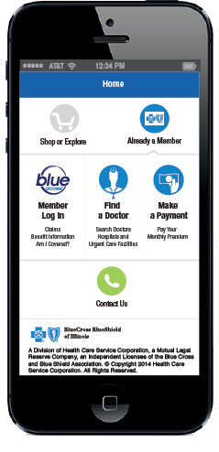

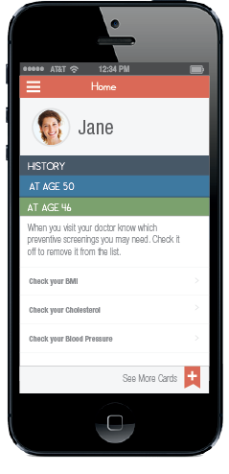
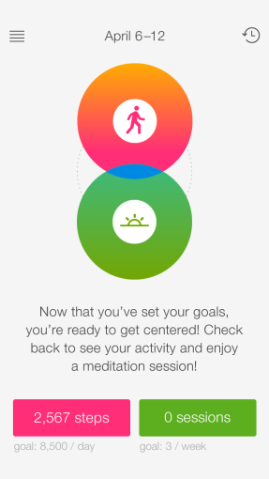
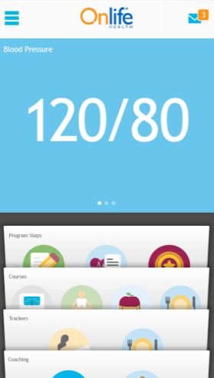
Mobile App Overview
BCBSTX App
Centered
Healthy Family
AlwaysOn
Well onTarget®
5
BCBSTX APP Text BCBSTXAPP to 33633
Centered Text CENTERED to 33633
Healthy Family Text FAMILY to 33633
Well onTarget (AlwaysOn) --Download from App Store
22
Notes:
You can stay connected with Blue Cross and Blue Shield of Texas and access your health insurance information anytime, wherever you are.
Here’s an overview of our Mobile Apps.
BCBSTX App—Provides access to Blue Access for Members, allows you to find a doctor, you can view your ID card, or order a new one. This app is available for iPhone, iPad and Android phone. To get the app, text BCBSTXAPP to 33633
Centered App—Is a holistic approach to wellness by integrating mindful meditation and encouraging daily physical activity to help reduce stress and improve overall health. This app is available for iPhone and Apple Watch. To get the app, text CENTERED to 33633.
Healthy Family--Helps you and your family keep track of recommended screenings and vaccinations. This app also allows you to add historical test results to track progress towards wellness goals. You have the ability to set reminders on tests needed and you can also add notes for questions to ask your doctor on your next visit. This app is available for iPhone and Android. To get the app, text FAMILY to 33633.
Well onTarget (Always On) –Allows you to complete your health assessment , view your health stats (weight, blood pressure, etc), set personal health goals, track your progress and view your Blue Points. This app is available for iPhone and Android users. To get the app, search “Well on Target” in the app store.

Slide 23
Naturally Slim®
What is Naturally Slim?
  A weight loss and metabolic syndrome reduction program
  On average over 10 pounds lost in 10 weeks and a 50% metabolic syndrome reversal rate.
Notes:
What is Naturally Slim?
A weight loss and metabolic syndrome reduction program with an average of over 10 pounds lost in 10 weeks and a 50% metabolic syndrome reversal rate.
It consists of online, web based videos for the first ten weeks --Foundation Program, then continues to 7 bi-weekly videos in our NS4You reinforcement program, and finishes with 6 monthly videos in our NS4Life maintenance.

Slide 24
Naturally Slim®
  Offered to employees, retirees and their spouses in the A&M Care, 65 PLUS or J plans.
    For eligible, accepted participants, the program is provided at no costs.
  To qualify, you must have a risk factor related to Metabolic Syndrome.
    BMI over 30 or a BMI over 25 plus an additional risk factor.
  After acceptance, participants watch a series of weekly videos instructing them on the Naturally Slim® program principles.
    You will be notified when you can apply for the classes
Notes:
Naturally Slim
It’s offered to employees, retirees and their spouses in the A&M Care, 65 PLUS or J plans.
For eligible, accepted participants, the program is provided at no costs.
To qualify, you must have a risk factor related to Metabolic Syndrome.
BMI over 30 or a BMI over 25 plus an additional risk factor.
After acceptance, participants watch a series of weekly videos instructing them on the Naturally Slim® program principles.
You will be notified when you can apply for the classes

Slide 25

Identify Protection Services
Offered through Experian at no costs to employees, retirees and their dependents enrolled in the A&M Care Plans.
You must be an active employee or retired from the A&M System and enrolled in the A&M Care or 65 Plus Plans.
You must sign up directly with Experian for identity protection services.
Visit the A&M System Benefits Administration website at www.tamus.edu/business/benefits-administration/employeeretiree-benefits/id-protection/ for more details and to learn how to enroll.
Notes:
BCBSTX offers additional identify protection services offered through Experian at no costs to employee, retirees and their dependents enrolled in the A&M Care plans.
To take advantage of this service, you must sign up with Experian.
Adult members and dependents over age 18 can enroll through the web site shown above.
Services include an Experian Credit Report upon signing up
Comprehensive educational resources
Daily Bureau Credit Monitoring
US Based Customer Support 7 days a week
A fraud resolution team.
Once you enroll, you can enroll dependents under age 18.

Slide 26

The BVA
Benefits Value Advisor
ONE CALL SOLUTION
Help you understand your benefits
Cost comparison on X-rays, MRIs, CT Scans, maternity services, surgeries
Appointment scheduling
Find in-network providers
Help you access online educational tools
EDUCATION • GUIDANCE • SUPPORT
Notes:
Blue Cross Blue Shield of Texas is working to help you maximize your benefits, and plan for your health care. Now you can speak to a Benefits Value Advisor who can help you:
Understand your benefits
Find network providers
Help you access online educational tools
A Benefits Value Advisor can also provide cost comparisons on services such as:
MRIs, CT scans and X-rays
Maternity services
Surgeries (ie. Back, shoulder, hip or joint)
If the cost comparison identifies a lower cost facility for your service, the Benefits Value Advisor can also assist with appointment scheduling.
To reach a Benefits Value Advisor, call the customer service number on the back of your Blue Cross Blue Shield of Texas ID card at 1-866-295-1212.

Slide 27




How to Find a PPO Provider
Call Customer Service on the back of your ID card
866-295-1212
From your computer OR mobile phone, log on to bcbstx.com
and click on
“Doctors and Hospitals”
For Worldwide Assistance, call
1-800-810 BLUE (2583)
Notes:
The A&M Care and J Plan are both PPO plans.
On a PPO plan, you receive the highest level of benefits when using a provider in the PPO network.
It’s easy to locate a network provider. You can either:
Call customer service, Or
Search online from your computer or mobile phone
For worldwide assistance, you can call 1-800-810-BLUE (2583).

Slide 28

Service that Takes You Out of the Middle
Call your BCBSTX customer service team
  Medical benefit coverage questions
  Help with finding network providers
  Help from a Benefits Value Advisor
  ID card requests
  Help with navigating online tools
  Health education and transfer to
  other health programs
  Claim questions or status
866-295-1212
8 am to 8 pm / CST
Monday -Friday
Notes:
To learn more about the A&M Care Plan,
please contact Blue Cross and Blue Shield of Texas Customer Service 866-295-1212. This unit has been set up specifically for the members of Texas A&M University System.
Customer Service Representatives are available from 8:00 am to 8:00 pm –Central Standard Time, Monday through Friday, to assist with:
Medical benefit coverage questions
Identify Network Providers
Help from a Benefits Value Advisor
ID Card requests
Help with online tools
Health education and transfer to other health programs
Claim questions or status

Slide 29
Questions?
Your 2016-2017
A&M Care Benefits At-a-Glance
Notes:
29
Thank you for attending.

