Slide 1
Open Enrollment Meeting
Texas A&M University
FSA Open Enrollment with Navia Benefit Solutions

Slide 2
What is Section 125?
Section 125 of the IRC allows you to pay for qualified expenses on a tax-free basis. The monies deducted under a Section 125 plan effectively lower your gross income and your taxable base.
All monies deducted pre-tax are exempt from Federal Income Tax (FIT), FICA and even some state income taxes. This can result in savings of 30 - 40%
When you use your FSA to pay for eligible expenses you get to pay for expenses you were already going to incur and take home more of your paycheck!!

Slide 3
Flexible Spending Arrangements
A Flexible Spending Arrangement (FSA) plan enables you to set aside money on a pre-tax basis to pay for out-of-pocket health care and/or day care costs. Your FSA plan year is September 1st, 2019 through August 31st, 2020 and all claimed expenses must have dates of service that fall within the plan year.
This benefit covers you, your spouse and any tax dependent(s). Your eligibility for this benefit is not based on the status of your insurance coverage through your employer.
Run Out: claims for the above plan year must be filed by December 31st, 2020.

Slide 4
Health Care FSA (HCFSA)
This benefit is used to pay for eligible out-of-pocket expenses that are medically necessary. The health care FSA is a pre-funded. You have access to the full annual election amount at the beginning of the plan year.
Unlike insurance benefits, the health care FSA covers you and your dependents even if you are not covered under your employer’s benefit plans.
The maximum amount that you set aside for your Health Care FSA is $2,700.

Slide 5
2 ½ Month Grace Period
The 2 ½ month Grace Period provision gives your plan year an extension so that any expense incurred from September 1st, 2020 through November 15th, 2020 can be submitted against the plan year that ended on August 31st, 2020.
Claims submitted against the prior plan year must still be submitted by the claims run-out deadline of December 31st, 2020.

Slide 6
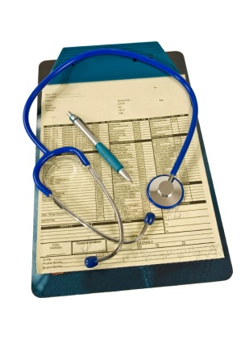
HCFSA Eligible Expenses
Under IRC Section 213(d), the expense must be to “treat a medical condition” to be considered eligible for reimbursement. This includes common expenses such as:
Copayments, prescriptions, deductible and coinsurance amounts
Dental and orthodontia expenses
Vision expenses such as lenses, contacts, frames etc.
Acupuncture, chiropractic, naturopathic doctors
Over-the-counter drugs
NOTE: All Over-the-Counter drugs and medicines will require a prescription in order to be reimbursed.

Slide 7
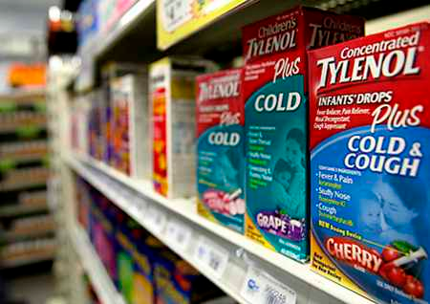
Over-the-Counter Drugs
Over-the-counter drugs and medicines (those that contain an active ingredient) will require a specific prescription in order to be reimbursed. Here are some quick tips to consider:
Have your provider write a general prescription like “OTC Pain Medication” or OTC Allergy Medication” instead of listing the specific items on the Rx (i.e. Advil, Midol, Claritin, etc…)
Call your doctor’s nurse line and ask for the prescription. It saves you time and a possible copayment
Send us the prescription and we’ll keep it on file for the entire plan year

Slide 8
Health Care FSA Ineligible Items
Ineligible expenses include those that are considered hygienic or cosmetic in nature or those that are not treating a medical condition. Some common examples include:
Cosmetic surgery, gym memberships, naturopathic medicines
Teeth whitening, veneers, Sonicare toothbrushes
Visit our web-site at www.naviabenefits.com for an extensive list of eligible and ineligible expenses.

Slide 9
Day Care FSA (DCFSA)
Child care can be a large expenditure for many families. The day care FSA provides some tax relief by allowing families to set aside pre-tax dollars to pay for qualifying expenses. To qualify, the care must:
Be for a dependent 12 and under (unless the dependent is physically or mentally impaired and cannot provide care for themselves, then no age limit)
Enable you and your spouse to work, actively look for work or be a full time student
Not be educational in nature (i.e. school tuition).

Slide 10
DCFSA
The Day Care FSA calendar year maximum:
$5,000 if you are married filing jointly
$5,000 if you are single
$2,500 if you are married filing separately
The Day Care FSA is not pre-funded; reimbursements are paid based on your account balance.
Eligible Expenses:
Before and after-school care
Day camps
Preschool
Ineligible Expenses:
Overnight camps
Kindergarten
Childcare while you are not working
Care provided by spouse or dependent

Slide 11
Submitting a Claim
We make submitting your claims as easy as possible. You can use one of the following methods:
MyNavia App – An easy-to-use mobile app that gives you real-time access on the go. Available for both Apple and Android devices
FlexConnect – Simple online auto-claim preparation tool for HCFSA
Online Submission – Log into your account at www.naviabenefits.com
Day Care FSA Recurring Claim – Simple online auto-claim tool for DCFSA
Paper Claim Form – Mail, fax or email your claim and documentation to us
Allow up to two (2) full business days for your claim to be processed. Reimbursements are issued according to your employer’s reimbursement schedule.
Or, use the Navia Benefits Card and skip the claim filing step!!!

Slide 12
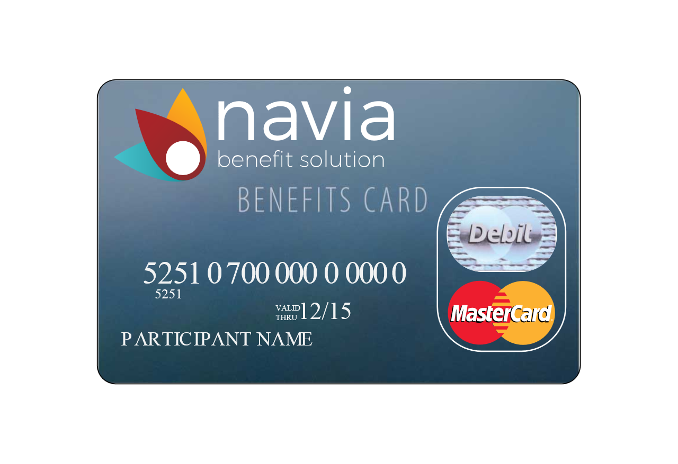
Navia Benefits Card
Rather than filing a claim and waiting for reimbursement, you can use the Navia Benefits Card to pay your provider directly for qualified expenses.
The card is accepted at participating merchants using the IIAS technology system and/or medical merchants setup with the MasterCard system.
Be sure to hang on to your receipts in case we need to see them to verify expense eligibility.
If we need to see a receipt, you will notice an alert on your mobile app and we will send you an email reminder

Slide 13
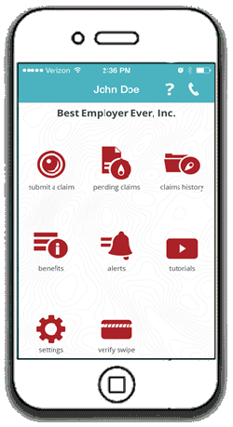
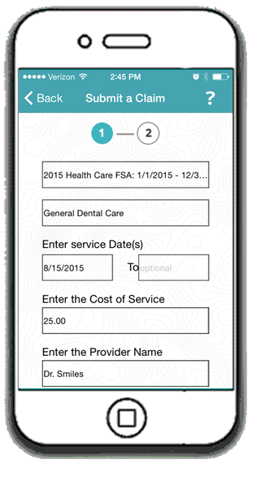
MyNavia App
The MyNavia App gives you real-time access on the go!
Submit your claims
Claim approval & reimbursement notifications
Update personal information
Substantiate debit card transactions
View active benefits and claims history
View pending claims
Available for download on Google play and the App Store

Slide 14
FlexConnect
Now you can FlexConnect your FSA
to your Medical, Dental and Vision carriers’ websites!
Step 1.
Enter Carriers
Step 2.
Enter Username/Password
Step 3.
Click “Reimburse me!”

Slide 15
Support
Our dedicated staff of customer service agents are available to assist you, Monday through Friday, between the hours of 5:00 am and 5:00 pm (PST). You can reach our customer service at (425) 452-3500 or toll-free at (800) 669-3539.
If email is more convenient, customer service can also be reached at customerservice@naviabenefits.com.

