Slide 1

A&M Medicare Part D
2020 Prescription Drug Program

Slide 2

Medicare Part D Prescription Drug Benefits
Annual Deductible | No annual deductible
Out of Pocket Maximum | $400 Single
Access Options | Generic Drug Copayment | Preferred Drug Copayment | Non-Preferred Drug Copayment
Retail – 30 Day Supply: Refills allowed as prescribed. (Good option for new prescriptions) | $10 | $35 | $60
Retail – 90 Day Supply: Refills allowed as prescribed Note – To get up to 90 days at retail, must use Walgreens, or certain smaller pharmacies. | $30 | $105 | $180
Home Delivery Pharmacy: Up to a 90-day supply*. Refills allowed as prescribed (Best option for maintenance medication) | $20 | $70 | $120

Slide 3
New to the Medicare Part D Plan?
You will receive your own new ID card with own unique ID info.
  Your spouse will receive separate ID card with own unique ID info as well.
You are automatically enrolled for Medicare Part D through Express Scripts if you are enrolled in the Blue Cross Blue Shield 65+ Plan.
A&M System intended for coverage to look almost exactly like your previous employee plan.
  There is extra coverage built into plan to cover non-part D covered drugs to minimize therapeutic disruptions.
You will have access Explanation of Benefits (EoB), a document outlining your prescription claims history on a monthly basis.
Annual confirmation of the Part D plan in October/November.
If you decide to enroll in a separate Part D plan, you must contact A&M System to be dis-enrolled from the A&M System Express Scripts Part D plan by Medicare.

Slide 4

Five ways to be a smarter pharmacy consumer
1
Ask your doctor for a generic or a lower-cost equivalent
Don’t be fooled by drug coupons
Use the most cost-effective pharmacy option
Take your medicines as prescribed
Set reminders to help you stay on track
2
3
4
5

Slide 5
Benefits of Home Delivery
Good option for long-term medications
Saving three monthly trips to a retail pharmacy
Automatic refills and renewals
24/7 pharmacist access from the comfort and privacy of your own home
Secure packaging that ensures your privacy
Free and safe delivery of your medicine
You can refill, renew and track your order using the mobile app or online at express-scripts.com
It’s easy to start: Express Scripts will contact your doctor for you to get your new prescription delivered right away!

Slide 6
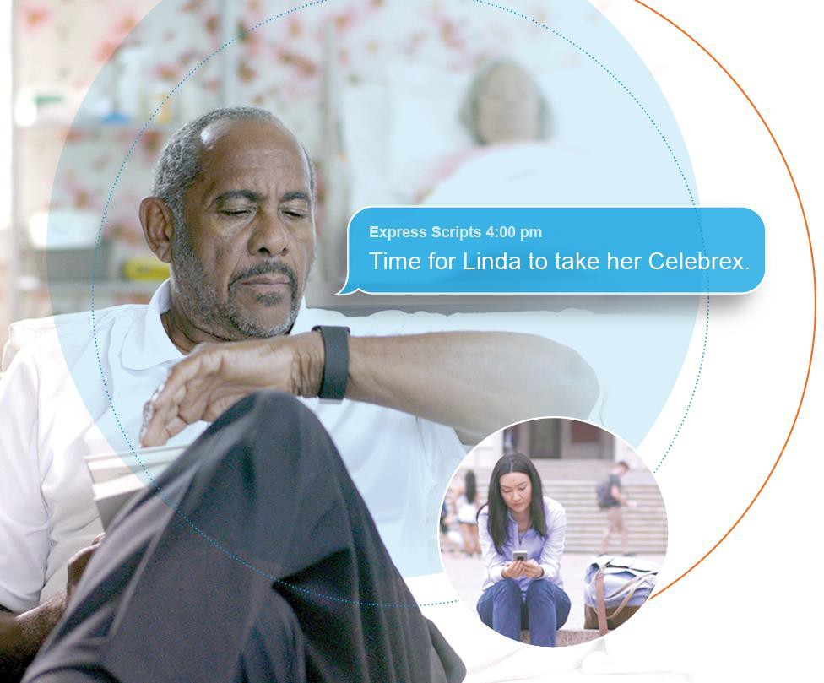



A simple pharmacy experience
Delivering what matters most to members
Info wherever and whenever
Help to keep on track
Optimize the pharmacy benefit
Flexible and personalized options
Care from anywhere

Slide 7
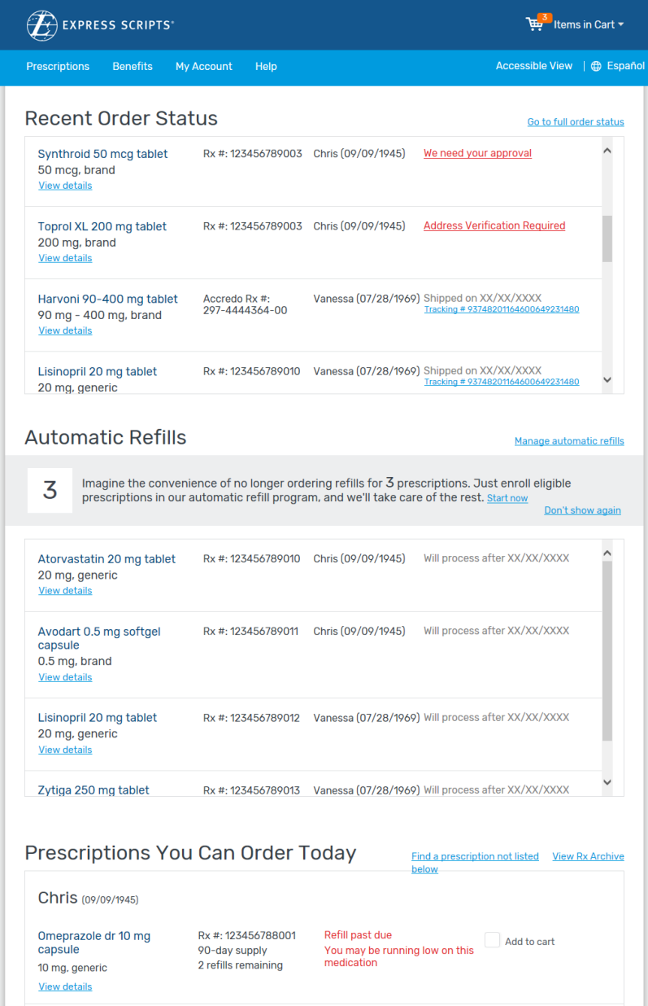
express-scripts.com
Manage your prescriptions online 24/7
Check order status with tracking
Refill a prescription
Enroll in automatic refills
Find ways to save money
Transfer a prescription from a retail pharmacy to home delivery
View claims, balances and prescription history
Receive online alerts if there’s a prescription-related safety issue

Slide 8
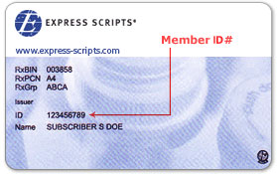
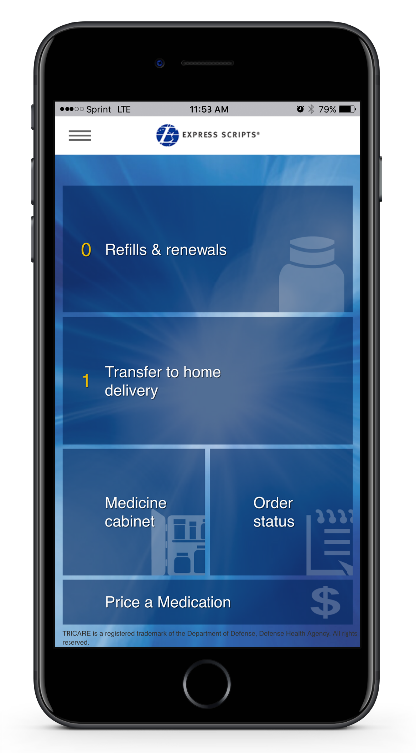
Member ID Card
The Express Scripts® Mobile App
Electronic ID card
Find a pharmacy
Price a medication
Reminder Notifications
Activate account on The Express Scripts Mobile App or express-scripts.com

Slide 9
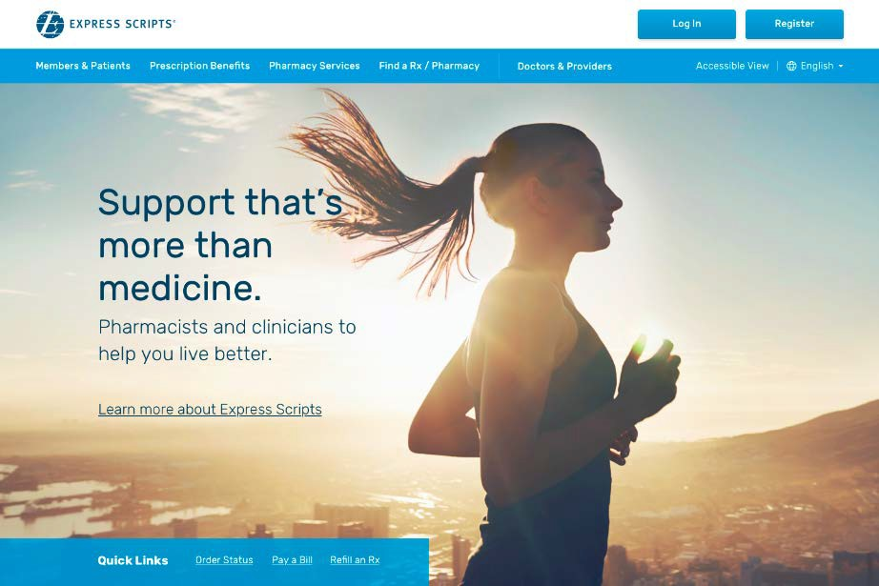
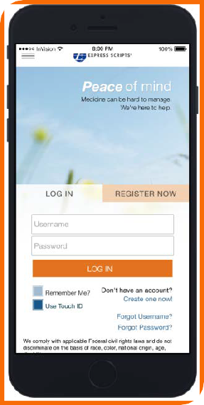
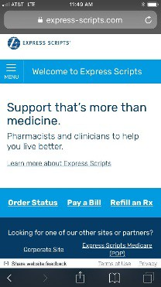



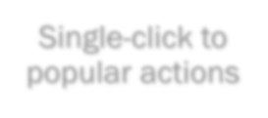



Connecting to Express Scripts is quick and easy with multiple ways to register
Members register one time, then simply log in.
Single-click to popular actions
© 2019 Express Scripts. All Rights Reserved.
© 2019 Express Scripts Holding Company. All Rights Reserved.

Slide 10

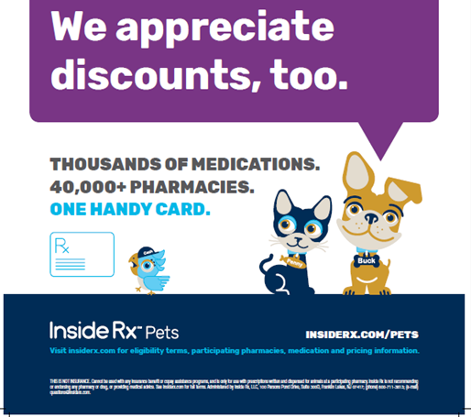

Slide 11
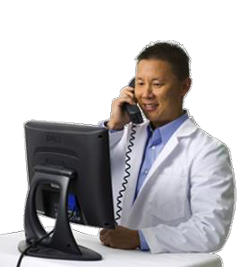
Have a Question About a Medication?
Ask a pharmacist
You can contact one of our pharmacists for general counseling — or a Specialist Pharmacist for complex concerns.
Each Specialist Pharmacist has had specialized training in the medications used to treat a specific condition, such as:
You can contact
a Specialist Pharmacist 24/7 to ask
questions about:
High cholesterol
High blood pressure
Depression
Diabetes
Asthma
Osteoporosis
Cancer
Drug interactions
Side effects
Risks and benefits of your medication
The challenges of taking your medication as prescribed — one of
the best ways to help
maintain or improve
your health
To reach a pharmacist, call the Express Scripts Member Services number on your ID card

Slide 12
We’re Here to Help
For any questions or more information about your prescription plan …
  Log in at express-scripts.com or get the Express Scripts mobile app at express-scripts.com/mobileapp
  Call the Member Services number on the back of your card
To speak to a pharmacist about your prescriptions …
  Call the Member Services number on the back of your card
To register to receive your prescriptions by home delivery …
  Log in at express-scripts.com or use the mobile app
  (Register using your member ID number or social security number)

Slide 13
Information Resources
A&M Benefits Website - https://tamus.edu/business/benefits-administration
  Pharmacy Benefit Highlights
  Download Forms
Express Scripts Member Website – www.express-scripts.com
  Formulary Information
  Locate a Participating Pharmacy
  Health and Wellness Information
  My Rx Choices® / Price a Medication
  Online Ordering
  Express Scripts Mobile App
  Order Home Delivery Pharmacy Refills
  Caregiver Resources
  Download forms
Med D Customer Service Number: 1-855-895-4647

Slide 14
Thank you

