Slide 1
Tax Advantaged Accounts
Flexible Spending Account (FSA)
Client Name: Texas A&M
Plan Year: 2016/2017

Slide 2
Today’s presentation will cover:
Flexible Spending Accounts (FSAs)
Health Care
Dependent Care
Using your account funds
The PayFlex Card®
Helpful tools and resources
PayFlex Mobile® App

Slide 3
What’s a Flexible Spending Account?
An FSA lets you set aside pre-tax money from your paycheck to use for eligible out-of-pocket expenses.
PayFlex is your FSA administrator.
There are 2 types of FSAs:
Health Care account
Dependent Care account
Note: You don’t need to be enrolled in your employer’s health plan, to enroll in an FSA.

Slide 4
What’s the benefit of an FSA?
Here’s an example of how having an FSA can help reduce your taxes and increase your take home pay!
*This is example is based on 7.65% FICA and 15% tax bracket.
Note: Be advised that this example is for illustrative purposes only. These projections are only estimates of tax information and should not be assumed to be tax advice. Be sure to consult a tax advisor to determine the appropriate tax advice for your situation. Actual tax savings depends on several variables, including state and local tax rates and the tax bracket of the individual.
Annual Salary | Health Care FSA Annual Contribution | Dependent Care FSA Annual Contribution | Savings
$30,000 | $1,500 | $0 | $340
$50,000 | $1,750 | $4,000 | $1,303
$70,000 | $2,000 | $4,500 | $1,472

Slide 5
Health Care FSA
A Health Care FSA makes it easy to save funds to use for eligible health care expenses that are not covered by insurance.
The Internal Revenue Service (IRS) annual health care FSA pretax contribution limit is $2,550.
If you and your spouse each have a health care FSA, you can each contribute $2,550.
You need to contribute a minimum of $20.00/month
Your entire contribution is available at the beginning of the plan year.
Your health care FSA funds can be used by you and:
Your spouse
Your child (to age 26)
Your tax dependent who is permanently and totally disabled

Slide 6
Health Care FSA Expenses
Some common eligible expenses include:
Medical & dental deductibles, co-pays and co-insurance
Prescriptions
Over-the-counter items (OTC)
Note: OTC drugs and medicines require a prescription
Hospital expenses
LASIK surgery and eye glasses
Contact lenses and saline solution
Hearing aids and batteries
Orthopedic devices
View a complete list of common eligible expenses on payflex.com, your PayFlex member website
This material is for informational purposes only. Eligible expenses and benefits may vary from employer to employer. In case of a conflict between your plan documents and the information in this material, the plan documents will govern. Please refer to your employer’s Summary Plan Description (“SPD”) for more information about your covered benefits.

Slide 7
Dependent Care FSA
A Dependent Care FSA is a great way to save funds for eligible child and adult care expenses.
The IRS annual dependent care FSA limit is $5,000 per household/family.
If you and your spouse each have a dependent care FSA, you can contribute up to $5,000 between the two of you.
You need to contribute a minimum of $40.00/month
Eligible expenses are used for:
Your eligible dependent under age 13.
Or for a spouse or dependent unable to take care of him/herself
To use your funds, you must be working.
If you are married, your spouse must either be working, looking for work, be a full-time student or incapable of self-care
Funds become available as they are deducted from your paycheck, and deposited into your account.

Slide 8
Dependent Care FSA
Some common eligible expenses include:
Child and adult day care
In-home provider (this can’t be your child under age 19, or someone you claim as a tax dependent)
Summer camps (not overnight)
Tuition through preschool
Before and after school care
View a complete list of common eligible expenses on payflex.com, your PayFlex member website
This material is for informational purposes only. Eligible expenses and benefits may vary from employer to employer. In case of a conflict between your plan documents and the information in this material, the plan documents will govern. Please refer to your employer’s Summary Plan Description (“SPD”) for more information about your covered benefits.

Slide 9
FSA Contributions & Using your Funds

Slide 10
Your FSA Contributions
Use-it-or-lose-it rule: Any unused funds left in these accounts are forfeited at the end of the plan year.
You have until Nov. 15 to use your account funds (grace period).
You have until Dec. 31 to submit claims to pay yourself back from your account (run out period).
You can change your contribution amount if you have a change in status (marital status, tax dependents, employment, etc.)
For dependent care, you can change your contribution if:
There is a change in your provider
There is a change in the cost for a provider
Note: to help plan your account contribution…think about the eligible expenses you had last year and/or this year. Then, what you expect next year.

Slide 11
How to use your FSA funds
Use the PayFlex Card®, your account debit card
(health care FSA only)
Use the card to pay for eligible expenses
Funds automatically come out of your account, if the funds are available.
One card for multiple PayFlex accounts.
Pay for an eligible expense with cash, check or a personal credit card. Then, pay yourself back from your account by:
Submitting a claim online
Through PayFlex Mobile® app.
Fill out a paper claim form and fax or mail it to PayFlex.
Quick Tips:
Download/print a claim from your account website.
An Explanation of Benefits (EOB) or a detailed receipt must be sent with your claim.
Enroll in direct deposit, for quick reimbursements!

Slide 12
A little more about the PayFlex Card®

Slide 13
The PayFlex Card®
A super easy way for you to spend the money in your PayFlex account/s.
Immediate payment from your account
Increases your personal cash flow
No claim filing
Easy to use
Simply swipe the card and select either “debit” or “credit.”
If you choose “debit,” you may need a PIN to complete the transaction.
After you swipe the card, our system automatically confirms whether you have enough funds to pay for the expense.
What can I purchase with the card?
You can use the card to pay for eligible expenses allowed under your plan.
Where can I use the card?
Physician and dentist offices, vision care providers, and hospitals
Grocery stores, discount stores, web-based merchants
Drug stores and retail pharmacies

Slide 14
Requests for Documentation
According to IRS guidelines, PayFlex is required to verify that all purchases made with a PayFlex Card® are for eligible expenses.
There may be times during the year that we need additional documentation for your card transactions.
If we need documentation, we’ll post an alert message online. You may also receive a Request for Documentation letter by mail of e-mail.
The deadline to respond will be in the Request for Documentation letter.
Common reasons why documentation may be requested:
The amount of the expense doesn’t match the insurance co-pay amount.
The description PayFlex received from the merchant doesn’t show the type of expense. This sometimes happens with dental and/or hospital expenses.
Helpful reminders:
Save all receipts and Explanation of Benefits (EOB) in case documentation is requested.
If you don’t have enough funds available in your account, the card will be denied.
If you already have a PayFlex Card that’s not expired, keep using the same card.
You can order an additional card online for your spouse or tax dependent at no cost.

Slide 15
It’s easy to get started

Slide 16
payflex.com – your member website
Before you enroll, you can view:
My resources: education materials, planning tools, forms and IRS publications.
Eligible expense items: general list of eligible expenses.
Savings calculator: estimate your expenses, help plan your contribution/s.
Frequently asked questions: understand more about each account.
Digital library: learn more about PayFlex accounts, and how they work.

Slide 17
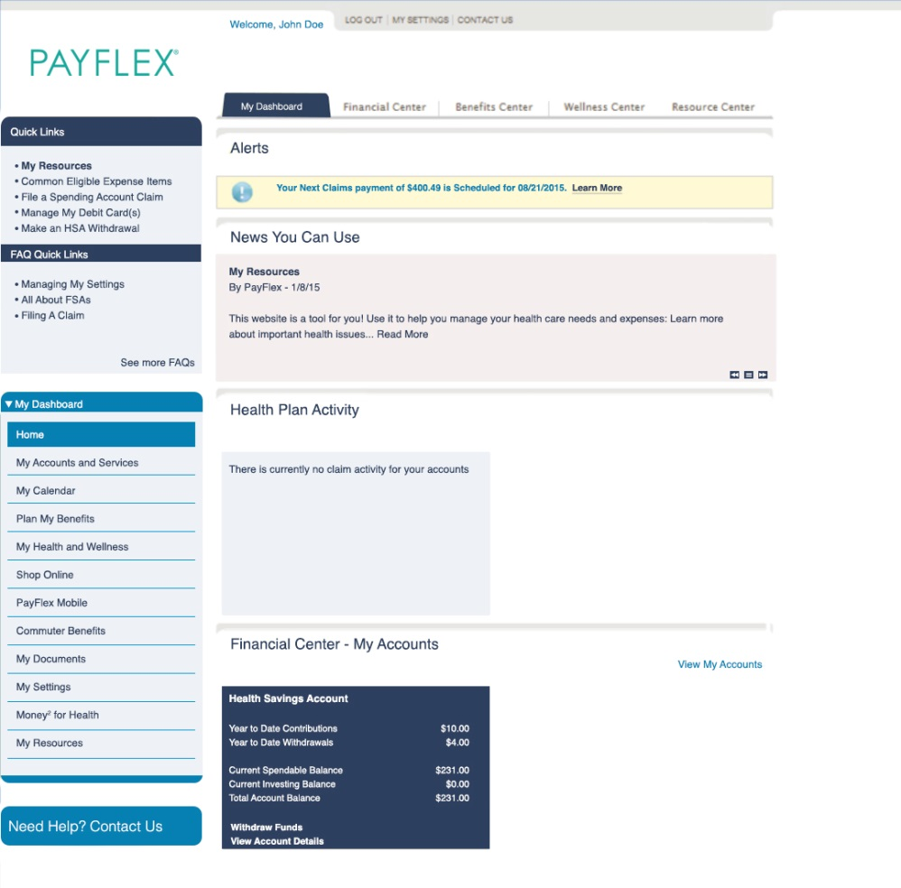
payflex.com
Once a member, from My Dashboard you can:
View your account balance(s)
Submit a claim to pay yourself back
Enroll in direct deposit
View upcoming payments and claim history
Print forms & educational materials
Sign up for electronic account notifications
View legislative updates and news

Slide 18
PayFlex videos to help you learn
Watch videos to learn more about your PayFlex account, and ways to manage your funds!
Various videos include:
Benefits of an FSA
Benefits of an FSA – Dependent Care
Staying Connected with PayFlex Mobile®
Using your PayFlex Card®
Making the most of your PayFlex Account

Slide 19
PayFlex Mobile® App

Slide 20
PayFlex Mobile®
Manage your account 24/7 with the free PayFlex Mobile® Application
Available for iPhone® and iPad® mobile digital devices, as well as Android™ smartphones.
The PayFlex Mobile® app lets you:
Manage your account funds
View PayFlex Card® purchases and submit documentation as needed
Snap a picture of your receipt, and upload to a specific expense
View a list of common eligible expense items
Use same username and password as the PayFlex member website
The iPhone and iPad are trademarks of Apple Inc., registered in the U.S. and other countries. Android is a trademark of Google Inc. Standard text messaging and other rates from your wireless carrier still apply. PayFlex Mobile® is a registered trademark of PayFlex Systems USA, Inc.

Slide 21
We’re here to help!
Visit payflex.com, click Contact Us.
Representatives are available Monday-Friday, 7 a.m. – 7p.m. CT and Saturday, 9 a.m. – 2 p.m. CT.
This material is for informational purposes only. The information describes the Flexible Spending Account (“FSA”) in general terms. FSA plans are governed by the rules of Section 125 of the Internal Revenue Code and will be administered in accordance with those rules. Estimate fund amounts carefully. Unused funds may be forfeited. Eligible expenses may vary from employer to employer. In case of a conflict between your plan documents and the information in this material, the plan documents will govern. Please refer to your employer’s Summary Plan Description (“SPD”) for more information about your covered benefits. Information is believed to be accurate as of the production date; however, it is subject to change. For more information about PayFlex, go to PayFlex.com. Financial Sanctions Exclusions. If benefits or reimbursement provided by this Agreement violate or will violate any economic or trade sanctions, the benefits are immediately considered invalid. PayFlex Systems USA, Inc. cannot make payments for claims or services if it violates a financial sanction regulation. This includes sanctions related to a blocked person or a country under sanction by the United States, unless permitted under a written Office of Foreign Asset Control (OFAC) license.
© 2016 PayFlex Systems, USA | APN: 69.25.304.1 B (7/16) - TAMU

