Slide 1
Soldier for Life Overview
LTC Jon Sowards
Director, Central Region, Soldier for Life
Unclassified

Slide 2
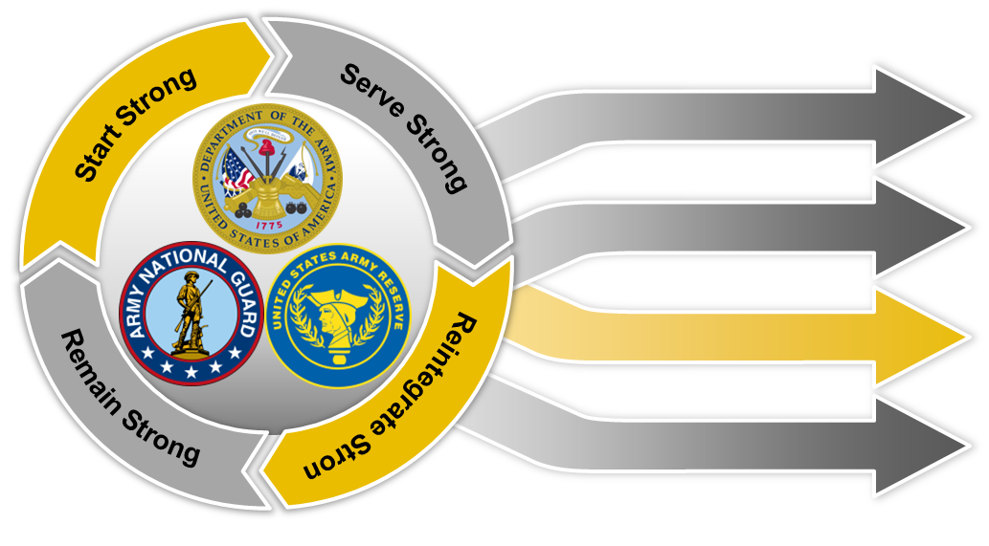
Soldier for Life Campaign
Mission
Soldier for Life connects Army, governmental, and community efforts to build relationships that facilitate successful reintegration of our Soldiers, Retired Soldiers, Veterans, and their Families in order to keep them Army Strong and instill their values, ethos, and leadership within communities.
Army
Government
Education
Health
Community
Employment
Information
Endstate
Soldiers, Veterans, and Families leave military service “career ready” and find an established network of enablers connecting them with the employment, education, and healthcare required to successfully reintegrate into civilian society.
Unclassified

Slide 3
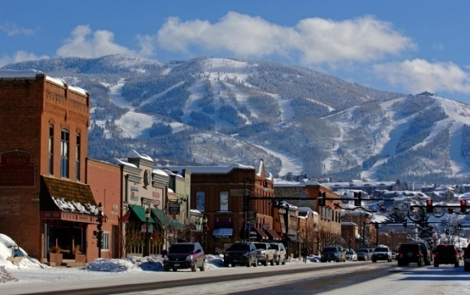
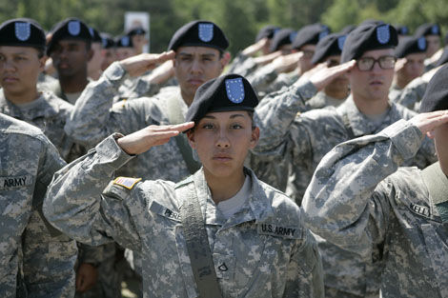
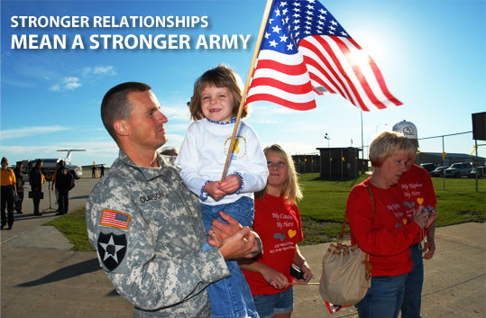
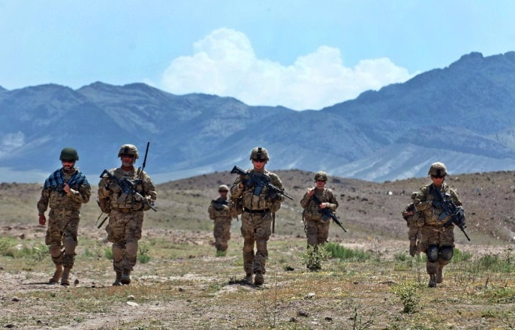
Soldier & Family Life Cycle
Serve Strong
Technical and Leadership experience
PME supports continued development
Credentialing, Certifications and Licensing
Family support and assistance programs
MySECO/MyCAA
ACT / COOL / JST
2
Serve Strong
Re-integrate Strong
SFL-TAP
Retirement Services
National Guard / Reserve
Army Network / Mentors
Community Action Teams
Apprenticeships/Internships
Military OneSource
Start Strong
Recruit Top 29%
HS Diploma / College
PaYS Partner (Partnerships for Youth Success)
Initial Entry Training (IET)
Future Soldier Spouse Orientation
Army Values and Warrior Ethos
Start Strong
Reintegrate Strong
1
3
Remain Strong
4
Remain Strong
Community Reception
National Guard / Reserve
VSO / MSO
Retired Soldiers / Veterans
Mentor, Leader, Volunteer
Community / Civic Leaders
Notes:
The Life Cycle is a continuous process with an endstate of making our Soldiers ‘Career Ready” throughout the lifecycle.
1. The first phase of the Soldier Life Cycle is Start Strong: The Army recruits from the top 29% of young Americans aged 18-24 (USAREC, 2015). Soldiers Start Strong when they first enlist in the Army and begin basic training at our many Basic training locations. They become Soldiers and are taught our Army values which instill in them the Warrior Ethos. This is also where he or she learns his or her military occupational specialty. Leaders need to instill in Soldiers at this point in their service that they are Soldiers for Life. “Once a Soldier, always a Soldier, a Soldier for Life!”.
2. The second phase of the Soldier Life Cycle is Serve Strong. This phase starts at the Soldier’s first duty assignment. The leader should address the importance of an individual development plan as well as transition planning during the initial counseling and subsequent professional growth and guidance counselings. This phase is where our Soldiers learn, prepare, and excel in completing the most difficult tasks asked by our Nation. Through their experiences as well as involvement in highly dynamic situations, our Soldiers become adaptable, skilled, team players that desire to Serve Strong. As Soldiers serve, they continue to become stronger through Professional Military Education, technical skills education, credentialing opportunities, civilian education and professional leadership training etc. Leaders must inform Soldiers about resources such as the Army Career Tracker (ACT), Credentialing Opportunities Online (COOL), the Joint Service Transcript and credentialing opportunities through the unit or civilian sources. As a Soldier for Life, Soldiers make an enduring commitment to strengthen our Army Profession.
3. The third phase of the Soldier Life Cycle is Reintegrate Strong. Transition can be stressful. These stressors and others are exacerbated by improper or late transition planning. Soldiers must approach the transition process throughout the Soldier Life Cycle. Whether a Soldier serves one term or retires, every Soldier will transition at some point. This is why early transition planning (talked about in the Serve Strong phase) is so important. The U.S. Army, through the Soldier for Life – Transition Assistance Program (SFL – TAP) offers a myriad of opportunities to assist a Soldier with the transition process. SFL-TAP is mandatory and the Commander is responsible for ensuring Soldiers attend. Leaders at all levels must be involved in their Soldiers’ transition process - ask for resumes or college acceptance letters, apprenticeships, ask for financial plans, talk to your Soldiers about job interviews and connecting with the Army Network etc. There are hundreds of Guard and Reserve centers, thousands of recruiters and millions of Veterans which includes more than 940,000 (2015) Retired Soldiers and 250,000 surviving spouses, they are all part of a large Army Network that Soldiers and their Families can learn to leverage for their benefit. Regular Army (Active Duty) Soldiers should strongly consider continuing their service in the Army National Guard or Army Reserves as well as joining local chapters of national Veteran Service Organizations such as the VFW or American Legion.
4. The fourth phase of the Soldier Life Cycle is Remain Strong. Maintaining the Premiere All Volunteer Army is an Army Imperative. This is accomplished when our Soldiers recommend service to the next generation. Soldiers must have a successful reintegration in order for future generations to see that Army service is beneficial. Successful employment, education and health are the keys to ensuring successful reintegration. Soldiers remain strong by serving as community leaders and mentors, being involved in Veteran Service Organizations and Military Service Organizations (VSOs/MSOs) and being Army ambassadors within the community.
5. There is a commensurate Family Life Cycle. There are resources for Spouses and Families throughout the Soldier Life Cycle. Resources such as Spouse education programs, Family support and assistance programs, Spouse attendance at SFL-TAP, and Military OneSource. Spouses and families continue to remain strong serving and volunteering in communities.

Slide 4
Scope
Active Army | ARNG | USAR | Retired Soldiers | Surviving Spouses | Total
490,326 | 349,042 | 198,698 | 944,793 | 249,765 | 2.23M
Army
Population
128,000 Soldiers separated from the Army in 2014
95,790 Soldiers separated in 2014
32, 210 Soldiers retired in 2014
Credentialing, Career Skills Programs and Student Veterans

Slide 5
Professional Requirements
Veterans to Work (VOW) Act of 2011; Public Law 112-56
Changes to Transition Assistance Program
ETS = attend Soldier for Life-TAP (ACAP) 365 days prior to ETS date
Retirement = attend Soldier for Life – TAP 730 days prior to retirement date
Army Directive 2014-18, Army Career and Alumni Program
Paragraph 3.a.: “Commanders will ensure that all transitioning Soldiers fully participate and meet all transition requirements.”
DoDI 1322.29: Job Training, Employment Skills Training, Apprenticeships, and Internships (JTEST-AI) signed 24 Jan 14
Army Directive 2015-12 (Implementation Guidance for Credentialing Program and Career Skills Program)
Authorizes Soldiers to attend a “career skills program” during last 6 months of service
Approval is O-5 level commander

Slide 6
Credentialing, Certificates, and Licenses (CCL)
Credentialing, Certificates, and Licenses (CCL)
Supports White House “We Can’t Wait” Initiative, Veterans Employment Initiative, and NDAA 2012
Recognizes that a civilian credentialed Soldier is a better trained Soldier and adds value to unit while also making them more employable upon separation
Designed to translate military skills into marketable civilian CCLs
96 Pilot Programs in 47 MOSs either implemented or planned
18,162 Soldiers enrolled in CCL programs, with 15,465 CCLs achieved
Army policy authorizes up to $800 per year for a Soldier to take a credential or certification exam that relates to their MOS.
Requires at least 1 year remaining on active duty
Credentials related to MOS’s can be using the Credentialing Opportunities Online (Army COOL) https://www.cool.army.mil/
Notes:
Fort Drum status:
National Tractor Trailer School (NTTS) – CDL training since 2010; as of July, 182 Soldiers had enrolled with 93% completing the course, 96% attaining their CDL
FASTPORT - connecting Soldiers with mentors in the truck driving industry
OSHA-10 Certification – first class in Jun 14; next class Oct (due to Teamsters funding)
Potential Programs:
Universal Technical Institute - working with John Decoteau; require two 30 x 30 classrooms; addressing challenges at Fort Bliss before expanding to additional installations; will take approx 1 year to establish program (credentialing)

Slide 7
Army University Initiative
Idea is to consolidate 200+ TRADOC education programs under one umbrella; anticipate fully operational by November 2017
ArmyU will work to improve transferability/acceptance of credits earned as Soldiers move from location to location
ArmyU seeks to expand accredited college credits for portions of PME offered throughout the Army's Centers and Schools
ArmyU seeks to develop/adopt additional nationally recognized professional certifications for more of its MOSs
ArmyU seeks to improve state/regional reciprocity of Soldiers' credentials
ArmyU seeks to expand partnerships and collaboration with civilian post-secondary education institutions (research, degree programs), businesses and industry (training with industry, technical certifications, etc.)
We believe professional certification and post-secondary degrees will help showcase our Soldiers as the professionals they are and will help to build competence, character, and commitment
Once Soldiers reach the ends of their careers in the Army, the certifications and degrees they earned while serving will be beneficial to them as they transition into civilian careers and continue to contribute to the betterment of our Nation
Notes:
Fort Drum status:
National Tractor Trailer School (NTTS) – CDL training since 2010; as of July, 182 Soldiers had enrolled with 93% completing the course, 96% attaining their CDL
FASTPORT - connecting Soldiers with mentors in the truck driving industry
OSHA-10 Certification – first class in Jun 14; next class Oct (due to Teamsters funding)
Potential Programs:
Universal Technical Institute - working with John Decoteau; require two 30 x 30 classrooms; addressing challenges at Fort Bliss before expanding to additional installations; will take approx 1 year to establish program (credentialing)

Slide 8
Career Skills Program
Partnerships with private industry and labor unions to train transitioning Soldiers for immediate high-skill job placement
Authorizes Soldiers within 180 days of separation to participate in apprenticeship and on-the-job-training a “career skills program”; approval is at the O5 Level
Supports Army Directive 2015-12 (Implementation Guidance for Credentialing Program and Career Skills Program, MAR 15)
Reduces/avoids Unemployment Compensation costs (high job placement rates to date)
Unique CSP industries include: automotive; welding, HVAC/R; truck driving; sprinkler fitter fire suppression; solar energy; communications; human resources; information technology; industrial applications; and manufacturing.
CSPs include: Apprenticeships, On-the-Job Training, Job Shadowing, Employment Skills Training, and Internships
Industry partnerships are key to success CSPs. ABF Freight (ABF) vignette
Over 98 CSP classes conducted between 1 Oct 2013 to 1 Aug 2015 across 15 installations
CSPs are optional based on the needs of the local Soldier population and the mission requirements as prescribed by the installation commander.

Slide 9
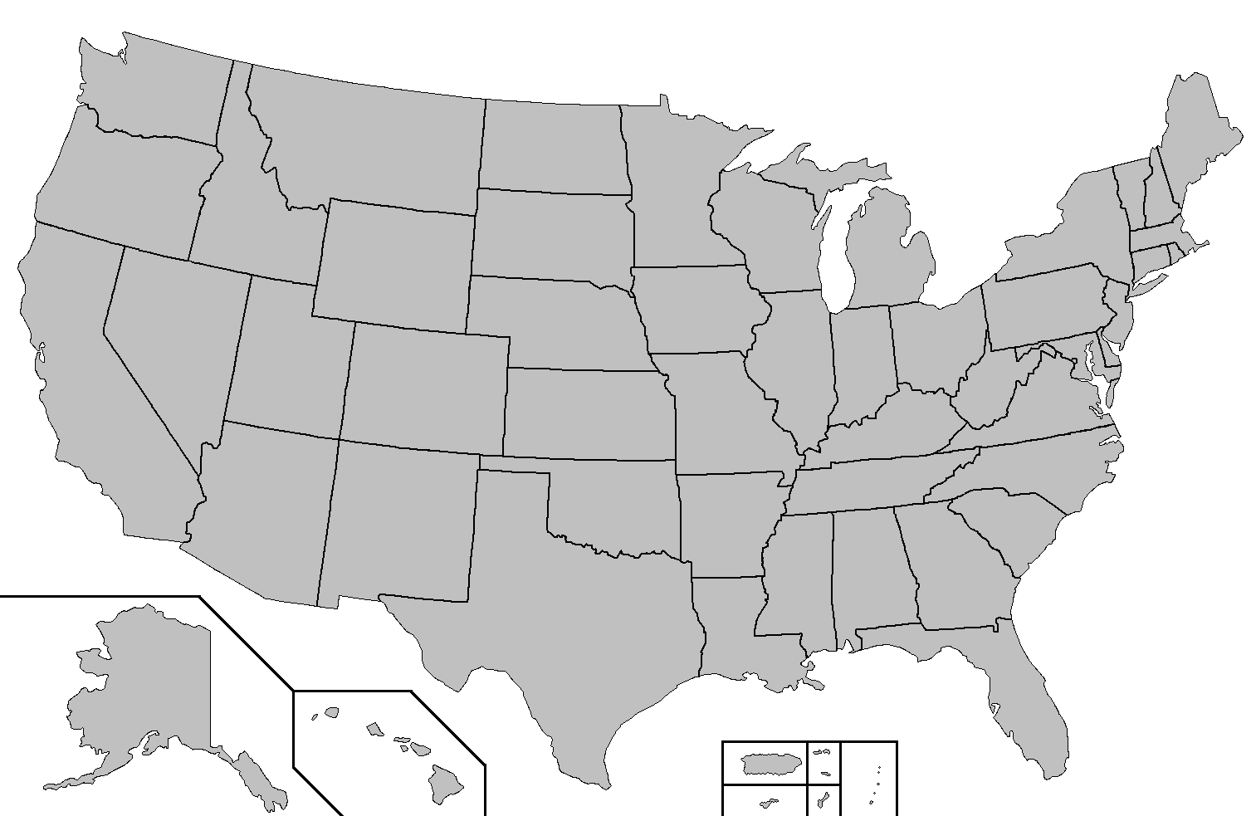
Local CSP Programs
Fort Carson, CO
Welding
Dep of Energy Pilot
Piping
Fort Riley, KS
CDL
Law Enforcement
Fort Campbell, KY
Piping
JBLM, WA
Piping
Welding
HVAC
CDL
Painters
IT/Software
Fort Drum, NY
CDL
Fort Eustis, VA
CDL
Fort Sill, OK
CDL
Sprinkler Fitter
Fort Bragg, NC
CDL
Facility Engineers
Fort Bliss, TX
CDL
Fort Gordon, GA
Firefighters
IT/Software
Fort Rucker, AL
Firefighters
Fort Stewart, GA
Power Lineman
JBL Audio Tech
Fort Hood, TX
Sheet metal
IT/Software
Piping
Shifting Gears/GM
Fort Polk, LA
Oil/Gas
Piping
Welding
Construction
Fort Benning, GA
CDL
Career Skills Program Reporting as of: 13 APR 2015
Unclassified

Slide 10
Who are today’s Student Veterans?
73% are male; 27% are female
Only 15% of Student Veterans are traditional aged college students; most are between 24 and 40
47% have children
47.3% are married
62% are first generation students
Source:
www.va.gov

Slide 11
Student Veteran Intangible Skills
More mature and focused
Strong leadership skills and ability to work with a team to get the job done
Ability to bring a group of differing backgrounds together to solve problems
Strong moral values
Know how to manage their time

Slide 12
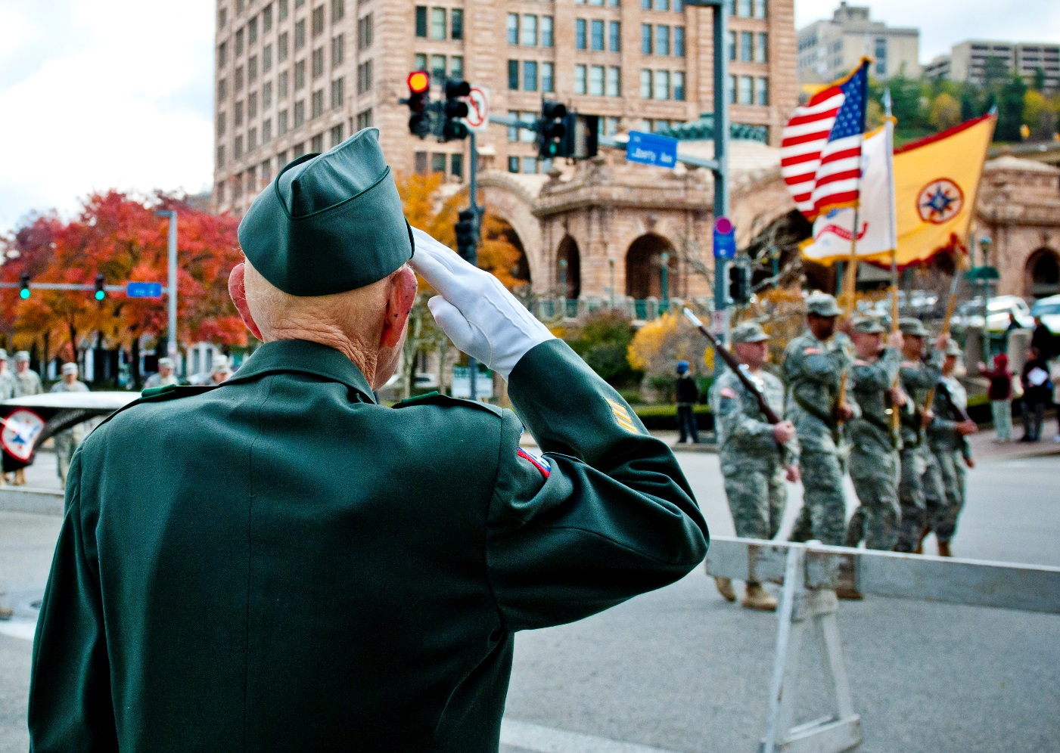
Questions
“Once a Soldier, Always a Soldier…A Soldier for Life!”
Unclassified

Slide 13
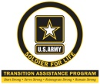
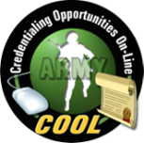
Resources
Soldier for Life - www.soldierforlife.army.mil/
Army Retirement Services - http://www.armyg1.army.mil/retire
Soldier for Life Transition Assistance Program - www.acap.army.mil/
Army National Guard and Army Reserve
Department of Labor (DOL VETS) - www.dol.gov/vets/programs/
eBenefits Employment Site –
Job Seekers: https://www.ebenefits.va.gov/ebenefits/jobs
Employers: https://www.ebenefits.va.gov/ebenefits/employers
Department of Veterans Affairs - www.va.gov
National Resource Directory - www.nrd.gov
Credentialing Opportunities Online (COOL) - https://www.cool.army.mil/
Joint Service Transcript (JST) - https://jst.doded.mil
Employers Support of Guard and Reserve - http://www.esgr.mil
My Army Benefits - http://myarmybenefits.us.army.mil/
Hiring Our Heroes (HoH) - http://www.uschamberfoundation.org/hiring-our-heroes
Institute for Military Veterans and Families - http://vets.syr.edu/
National Association of State Approving Agencies - http://www.nasaa-vetseducation.com/
National Guard Employment Network - http://www.msccn.org/NationalGuard/
Job Connection Education Program (JCEP) - http://jcep.info/
NRD.GOV
Unclassified

Slide 14
Join the Conversation
Facebook: www.facebook.com/StrongSoldierForLife
Twitter: www.twitter.com/csaSoldier4life
@csaSoldier4Life
#SoldierForLife
Website:
soldierforlife.army.mil
Unclassified

