Slide 1
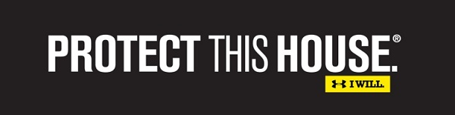

A Primer on Cybersecurity
NETWORK
    .
Melia Jones, Office of General Counsel
The Texas A&M University System

Slide 2
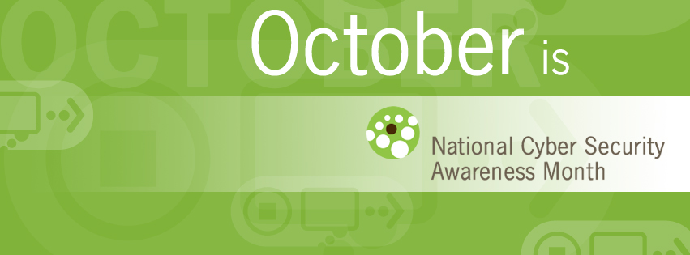
Introduction
Notes:
Timely
Policy Experience

Slide 3
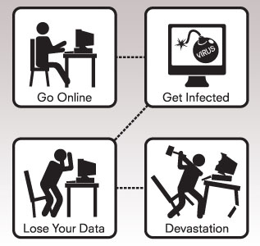
So you might be asking…
What is cybersecurity?

Slide 4
Basically….
Cybersecurity (also known as information technology security) is the focus on protecting computers, networks, programs, and data from unintended or unauthorized access, change, or destruction.

Slide 5
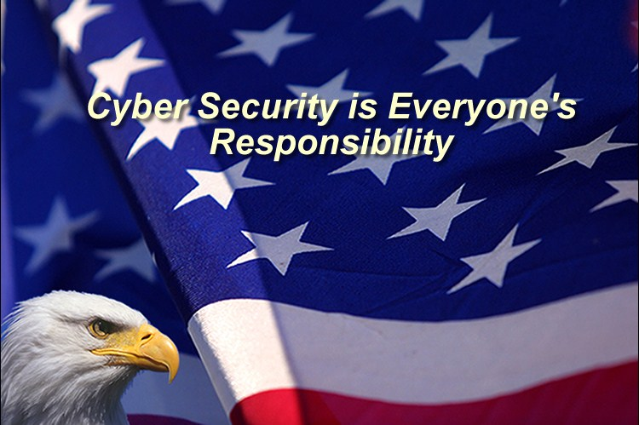
So you might still be asking…
Why should I care?

Slide 6
Because…
  Confidential information is collected on a DAILY basis.
  Governments, militaries, corporations, financial institutions, hospitals, SCHOOLS (!)—they all collect, process, and store immense amounts of confidential information on computers that transmit the data across networks to other computers.

Slide 7
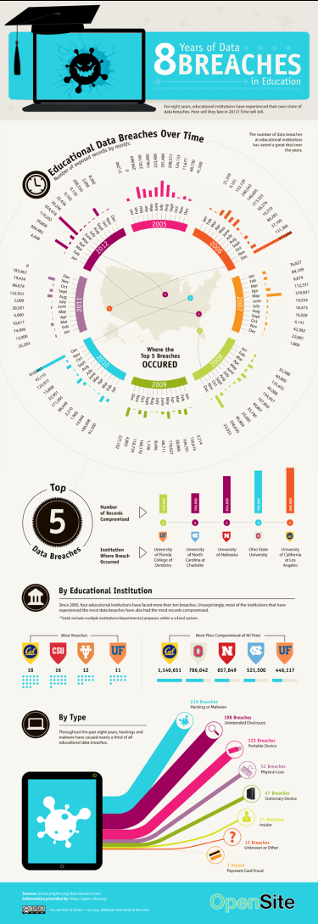
8 Years of Data Breaches in Education
Notes:
An analysis of all the data breaches from 2005 indicates that 21% of breaches occur in academic settings resulting in more than 8 million individual records being compromised. The “education” industry has the most number of breaches compared to any other industry category including medical, businesses, and government agencies. Further, fundamental differences exist between academic and business settings. It is common practice in businesses to protect trade secrets, intellectual property, etc. However, educational settings are based on values of information sharing. As it is pointed out, “…the concept of information security runs counter to the open culture of information sharing—a deeply held value in academe.” Therefore, it is important to raise awareness about the severity of security issues facing university setting.

Slide 8
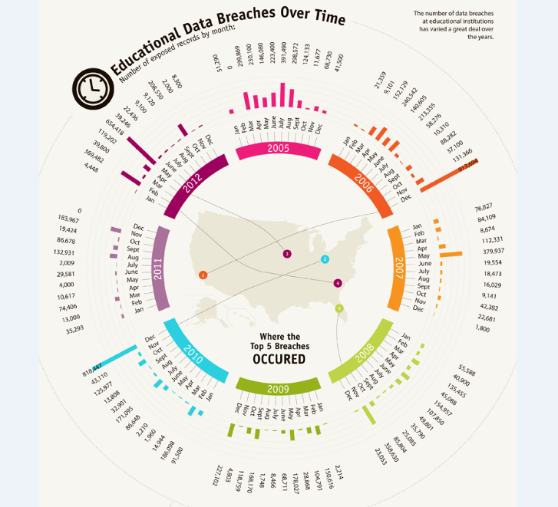
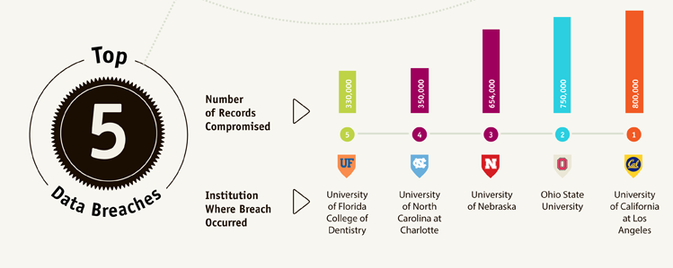
8 Years of Data Breaches in Education

Slide 9
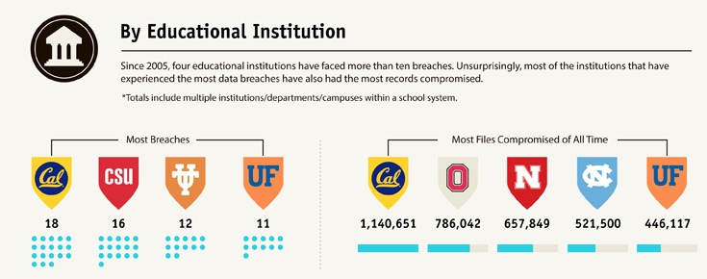
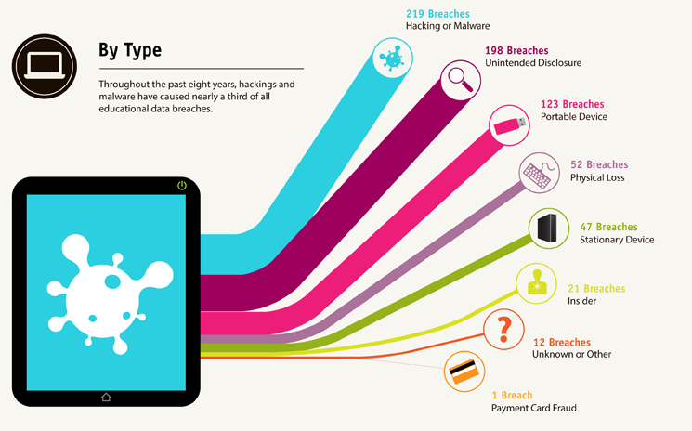
8 Years of Data Breaches in Education

Slide 10
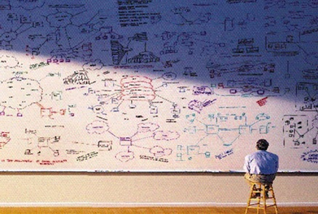
Where to begin?!

Slide 11
What is the objective?
Ensuring risks and threats are mitigated through implementation of programs, controls, and periodic assessments/audits

Slide 12
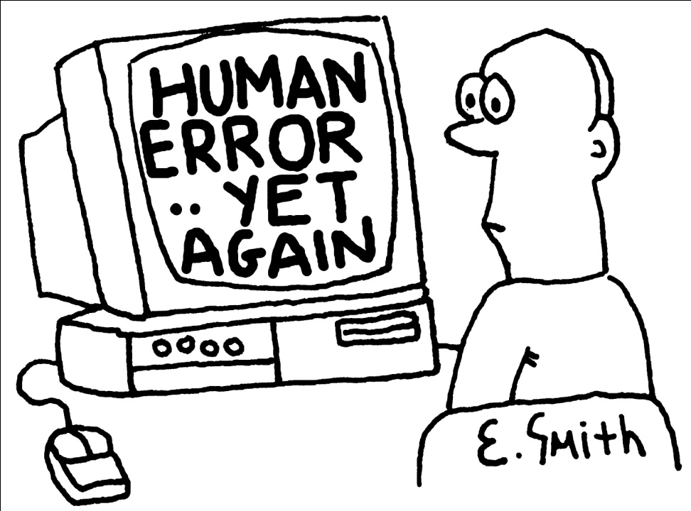
Examples of Threats…
Human Error or Failure
  Accidents or mistakes

Slide 13
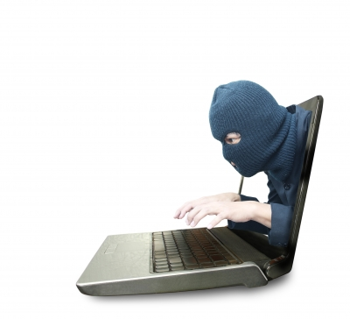
Examples of Threats…
Human Error or Failure
Acts of Espionage or Trespass
  Unauthorized access or data collection

Slide 14
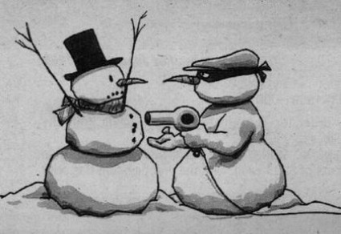
Examples of Threats…
Human Error or Failure
Acts of Espionage or Trespass
Acts of Information Extortion
  Blackmail of information disclosure

Slide 15
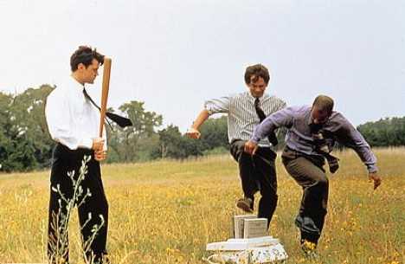
Examples of Threats…
Human Error or Failure
Acts of Espionage or Trespass
Acts of Information Extortion
Acts of Sabotage or Vandalism
  Destruction of systems or information

Slide 16
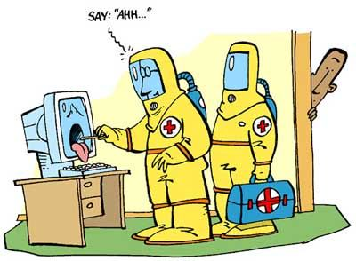
Examples of Threats…
Human Error or Failure
Acts of Espionage or Trespass
Acts of Information Extortion
Acts of Sabotage or Vandalism
Software Attacks
  Viruses, worms, macros, denial of service

Slide 17
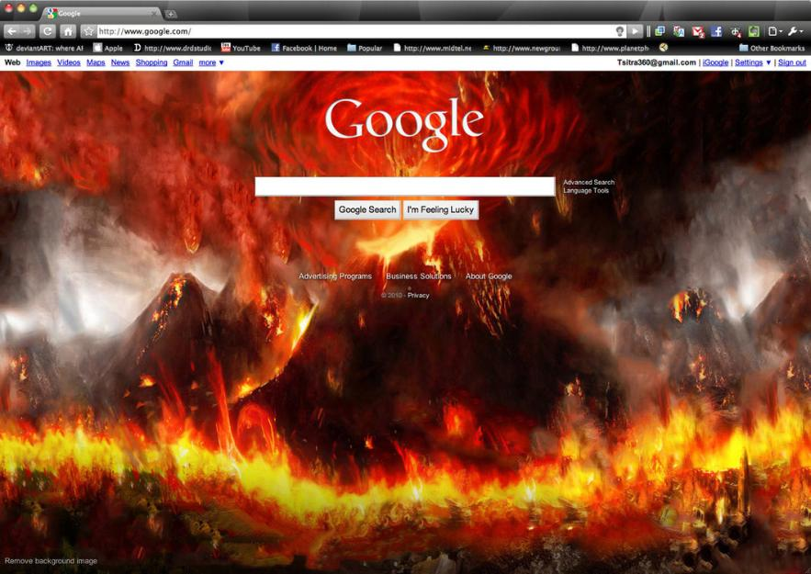
Examples of Threats…
Human Error or Failure
Acts of Espionage or Trespass
Acts of Information Extortion
Acts of Sabotage or Vandalism
Software Attacks
Forces of Nature
  Fires, floods, earthquakes, lightning

Slide 18
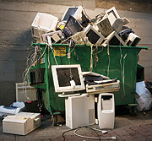
Examples of Threats…
Human Error or Failure
Acts of Espionage or Trespass
Acts of Information Extortion
Acts of Sabotage or Vandalism
Software Attacks
Forces of Nature
Technological Obsolescence
  Antiquated or outdated technologies

Slide 19
But at the end of the day…
A system should be:
  Protecting the organization's ability to function
  Enabling safe operation of applications
  Protecting data collected, used, and transmitted
  Safeguarding the technology assets

Slide 20
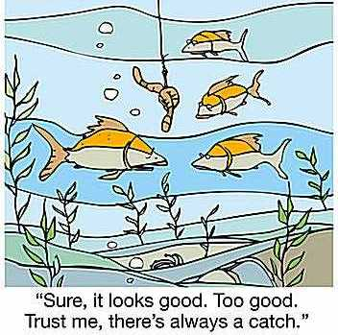
There has to be a catch though, right…

Slide 21
Well yes, there is…
Basic security dilemmas:
Good security can only be developed if everyone understand and security means AND agrees with the need for security
Security and its social component
  Defined by users
Harsh reality
  Lack of understanding
Reactive process
  Breach of system is what alerts you to a problem

Slide 22
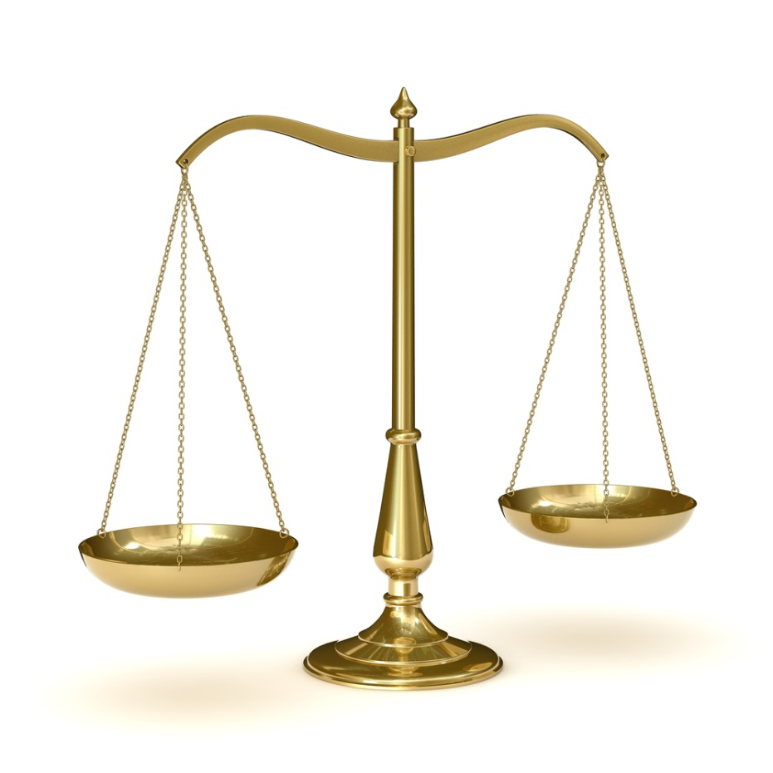
Security’s Inherent Balancing Act
Access
Security

Slide 23
Security’s Inherent Balancing Act
Security is not absolute
  Instead it is a balance of protection and availability
Too much security might make access hard to attain and people will not use the system. However, too easy of an access protocol and a security hole in the network might exist
Access
Security

Slide 24
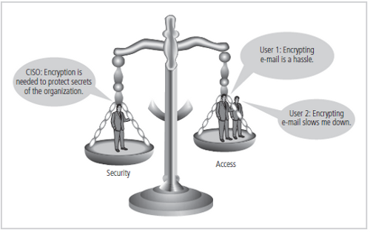
A Balancing Act…

Slide 25
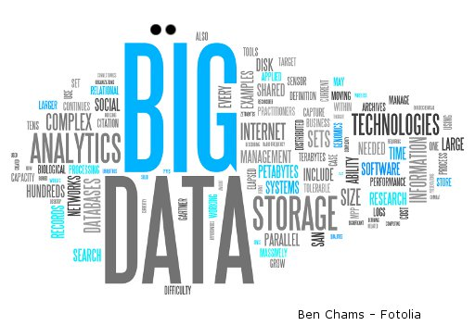
Buzz Words and Hot Topics
Big Data

Slide 26

Buzz Words and Hot Topics
Cloud Computing

Slide 27
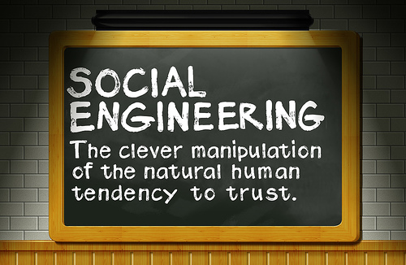
Buzz Words and Hot Topics
Social Engineering

Slide 28
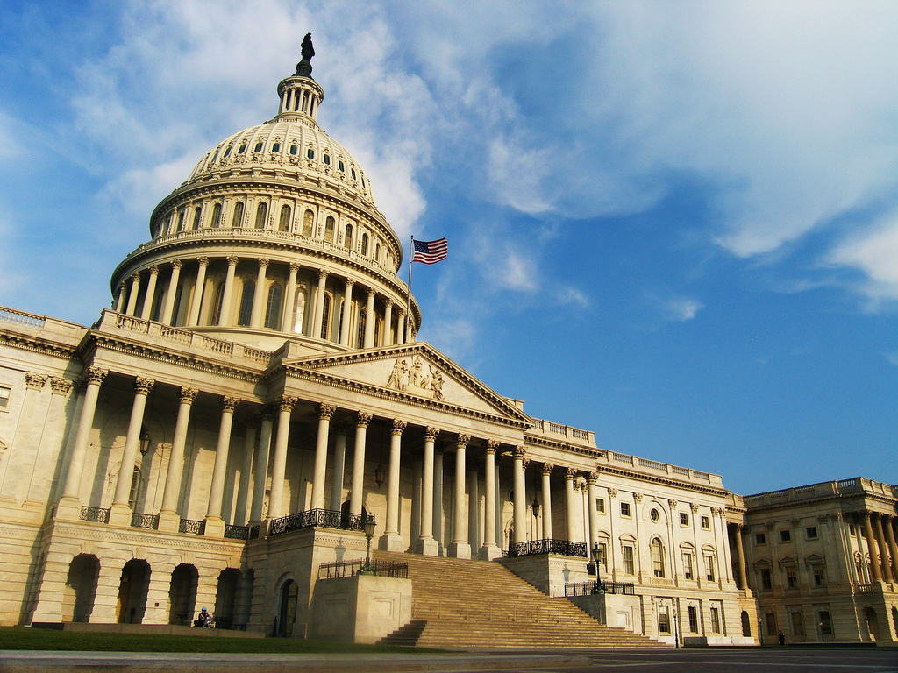
Well what is everyone else doing?
The Federal Government:
President’s Executive Order
H.R. 756 & S. 1353

Slide 29

Well what is everyone else doing?
TAMUS:
Deloitte IT Assessment
Compliance focus

Slide 30
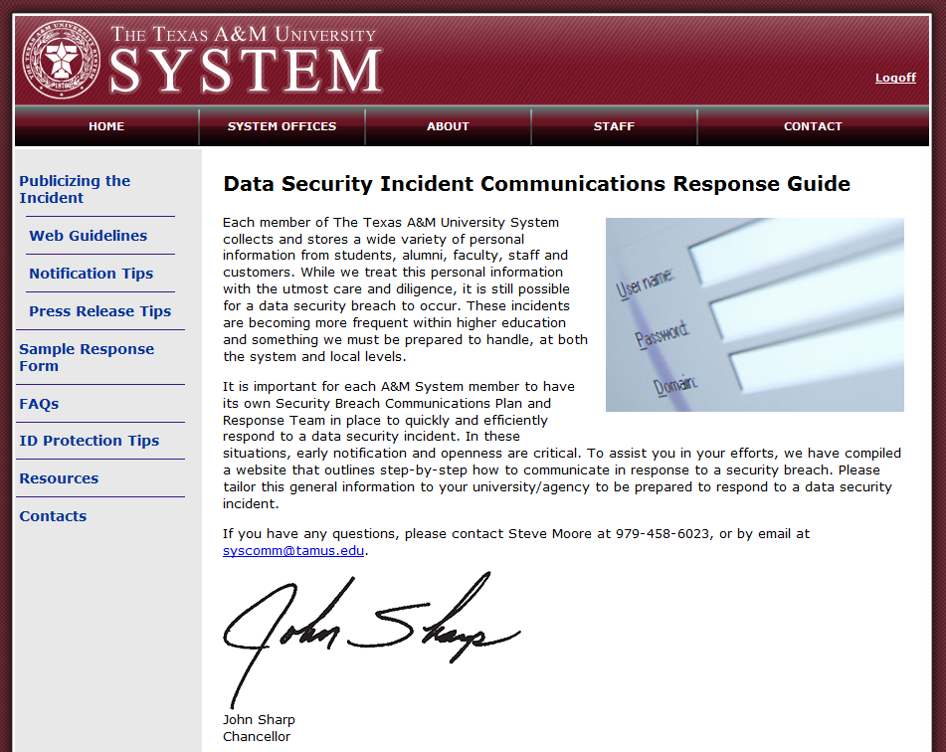
Well what is everyone else doing?

Slide 31

Break Out Session

Slide 32

Discussion

Slide 33
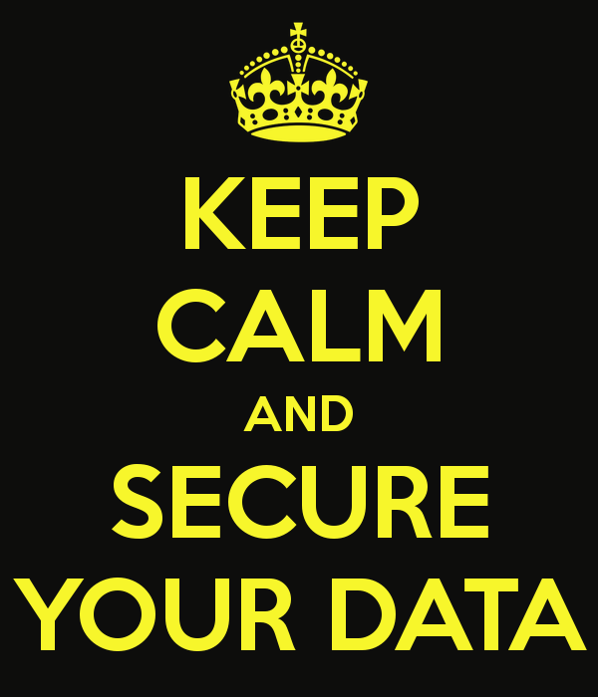
Questions?

