Slide 1
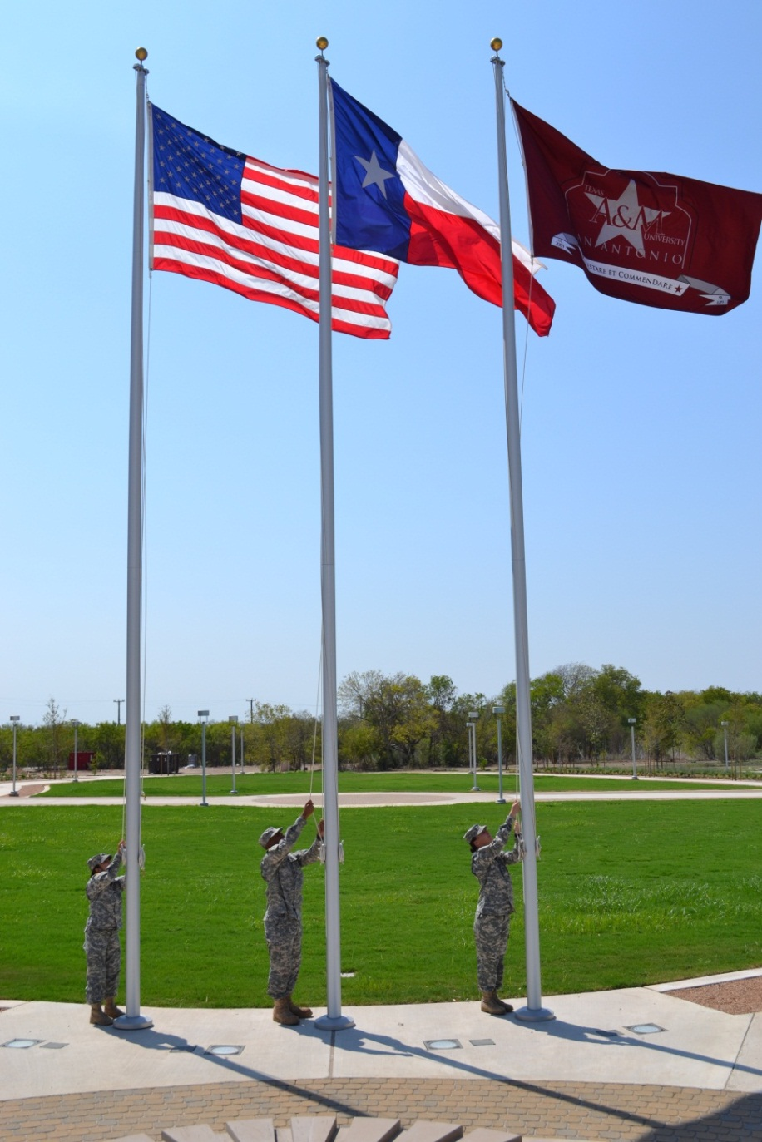
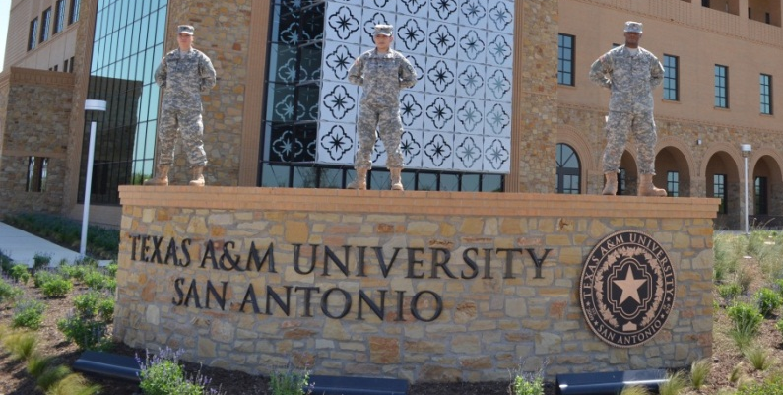

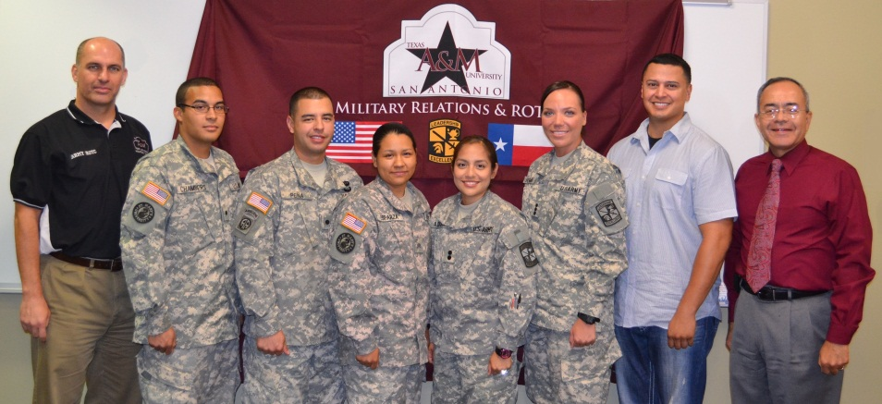
Notes:
Mission Statement
Our mission is to provide quality service in assisting our military service members and veterans in making their transition from military to academic life.
Goals
Our goals of the Veterans Certification and Military Community Relations Office are to provide quality service to our students who have served our country on active duty, and as reservists, National Guard, and their dependents (spouses and children). We expand our military-friendly services and programs for America’s finest who are returning home from over sea’s by preparing them with all information on well earned and deserved educational benefits. Our office is a guided resource to insure our students pursue and achieve their educational goals, along with professional and vocational objectives.

Slide 2

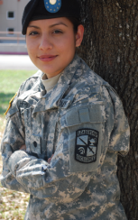
Military Embracing ™
Patriots’ Casa
  Central Campus
  Stand Alone Facility
  Co-curricular Learning
Army R.O.T.C. Program
Master’s in Counseling with
an emphasis on Military Families
B.A.A.S. (Bachelor of Applied Arts & Sciences)
Nationally Ranked Top
Military Friendly
Schools
For 2013
G.I. Jobs
Notes:
TAMU-SA was named as a top military friendly school for 2013;

Slide 3
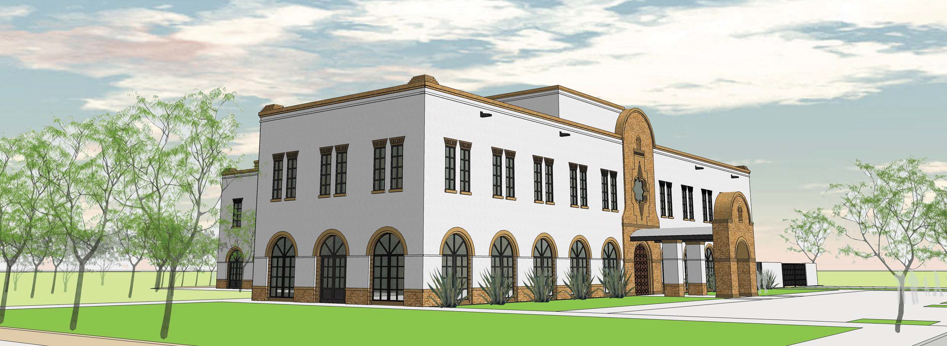
TEXAS A&M UNIVERSITY-SAN ANTONIO
Patriots’ Casa
estimated date of completion July 2014
Notes:
We are excited about our Patriots' Casa , a free-standing building dedicated to the University‘s military student community. The Patriots‘ Casa will be the first of its kind in the country as a stand-alone building designed to provide a space to guide veterans and their families through the transition from military life to higher education and into the civilian workforce ready to begin new careers.

Slide 4
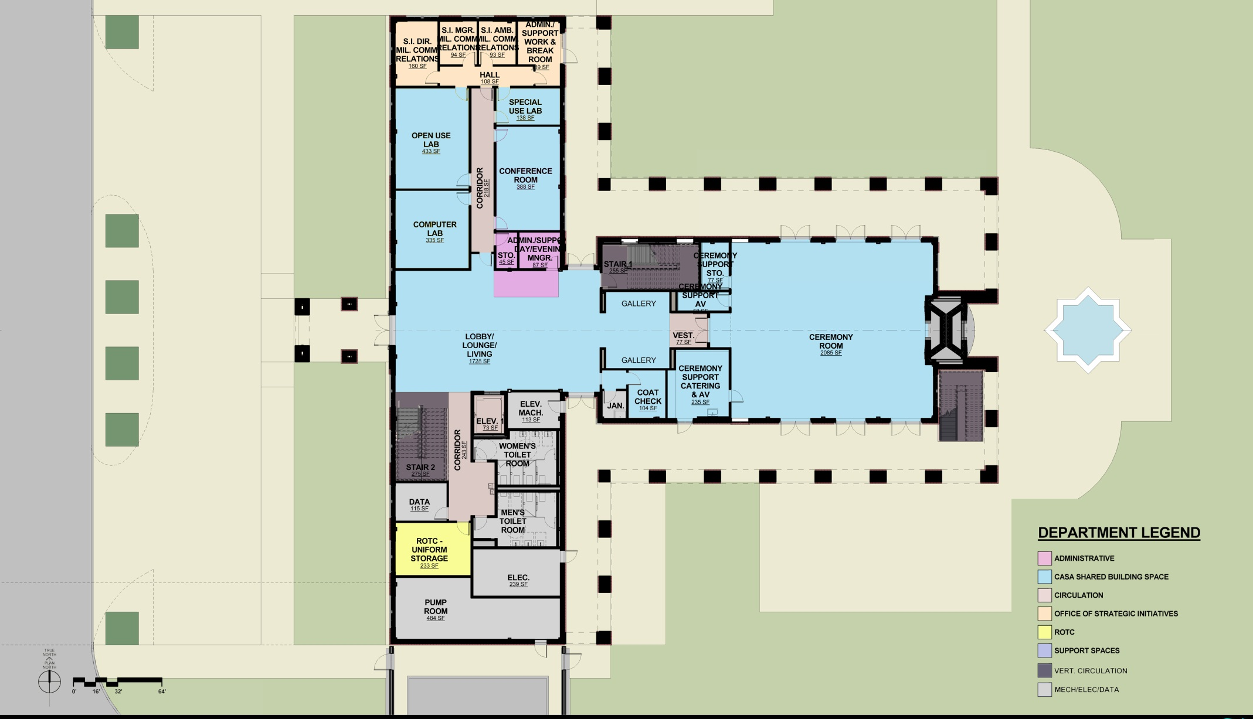

  Organizations Attending
Notes:
There are several way to enter into our accelerated Army ROTC program please contact our office for more details or to apply for the program.

Slide 5
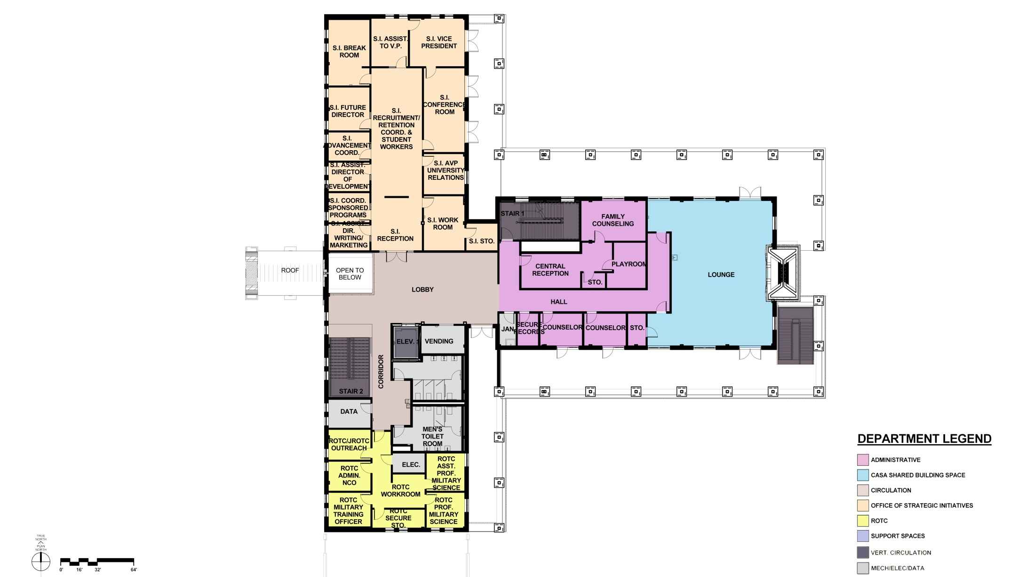
  Organizations Attending
Notes:
There are several way to enter into our accelerated Army ROTC program please contact our office for more details or to apply for the program.

Slide 6
PATRIOTS’ CASA MISSION
the patriots’ casa mission is to provide academic and psychological support
for student veterans, their military families, and military personnel enrolled
at the university. The dual purpose is to help ensure a veteran
with a GI bill will complete their academic training
and acclimate to an academic environment.

Slide 7

Notes:
There are several way to enter into our accelerated Army ROTC program please contact our office for more details or to apply for the program.

Slide 8
Saluting America’s Heroes
November 3, 2012
2:30 – 5:30 p.m. Veterans Benefits Fair with exhibits/demonstrations
by military and first responder
2:30 – 8 p.m. Taste of Cultures food fair
4 – 5:30 p.m. Groundbreaking ceremony
Central Academic Building & Patriots’ Casa
5:30 p.m. High School enlistment oath ceremony
6 p.m. ROTC cadet contracting ceremony
7 – 8 p.m. Lighted TAMU-SA Freedom 2-mile walk
Recognizing our Vietnam Veterans on the 50th Anniversary
An official event of the San Antonio Greater Chamber’s: Celebrating America’s Military
Notes:
There are several way to enter into our accelerated Army ROTC program please contact our office for more details or to apply for the program.

Slide 9
American Red Cross
Alamo Chapter AUSA
Army North
Army Recruiting Battalion
Brothers of Fallen Heroes
Coast Guard Recruiting Office
F7 Group
Haven for Hope
Marine Corps Recruiting
Military OneSource
Military Warriors Support Foundation
Navy Federal Credit Union
Navy Recruiting District San Antonio
Operation Homefront of Texas
Randolph Brooks Federal Credit Union (RBFCU)
Retired Military Working Dog Assistance Organization
SA K-9'S Service Dog Club
San Antonio Counseling and Behavioral Center
San Antonio Credit Union (SACU)
San Antonio Family Endeavors.org
San Antonio Stock Show and Rodeo - Rodeo Ticket Committee
Soldiers Angels
SoTX Chapter of C.O.P.S.
Texas Veterans Commission
Texas Veterans Land Board
Texas Veterans Leadership Program
TexVet Initiative
United Way of San Antonio 211
US Small Business Administration
Veterans Affairs Mobile Clinic
Vets' Journey Home Texas Inc.
VFW Post Kiernan #12117
Food Vendors
Chick-fil-A
Chuys
Dona Kika Tacos & Gorditas
EJ Sweets
Peach Weave Frozen Yogurt
Sabor Colombiano On Wheels
Zum Sushi
  Organizations Attending
Notes:
There are several way to enter into our accelerated Army ROTC program please contact our office for more details or to apply for the program.

Slide 10
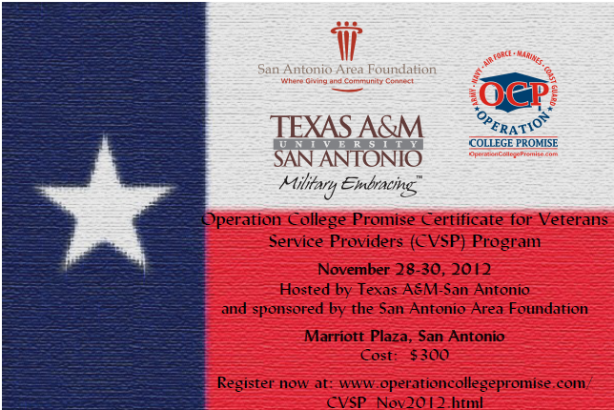
Notes:
There are several way to enter into our accelerated Army ROTC program please contact our office for more details or to apply for the program.

Slide 11
Program Content
Module 1 - Military 101: A Primer on Military Culture
Module 2 - What's New, What to Expect - An Update on the Status of the Post 9/11 GI Bill
Module 3 - Serving My Country - A Student Veterans Panel
Module 4 - Cracking the Code of Military Credit and Experience Transfer
Module 5 - Invisible Injuries of Contemporary Warfare
Module 6 - Resources for Veterans in Transition
Module 7 - Promising Practices in Veteran Support Services: A National Perspective
Program concludes with team exercises and presentations followed by a visit to a local military installation or other appropriate venue, as available.
  Serving our Veterans

Slide 12

Military Community Relations
Richard Delgado Jr., Manager of Military Community Support
(210) 784-1175 or (361) 549-7875 cell
Email: richard.degado@tamusa.tamus.edu
Joy Hutchinson, Military Field Ambassador
(210) 784-1177 or (210) 274-5408 cell
Email: joy.hutchinson@tamusa.tamus.edu
    Also like us on Facebook:
    Texas A&M University-San Antonio Military Relations
Notes:
Our office is lead by Dr. Charles Rodriguez, Major General, US Army Retired

